Slide 1
Relational Coordination as a Framework for Performance Improvement and Positive Change

Slide 2
Findings
Relationships shape the communication through which coordination occurs ...

Slide 3
… for better
Shared goals
Shared knowledge
Mutual respect
Frequent
Timely
Accurate
Problem-solving communication

Slide 4
… or worse
Competing goals
Exclusive knowledge
Lack of respect
Infrequent
Delayed
Inaccurate
“Finger-pointing” communication

Slide 5
This process is called
relational coordination
“Communicating and relating
for the purpose of task integration”

Slide 6
Investigated performance effects of relational coordination
Nine site study of flight departures over 12 months of operation at Southwest, American, Continental and United
Measured quality and efficiency performance, adjusting for product differences
Measured relational coordination among pilots, flight attendants, gate agents, ticket agents, baggage agents, ramp agents, freight agents, mechanics, cabin cleaners, fuelers, caterers and operations agents
Gittell, J.H. (2003). The Southwest Airlines way: Using the power of relationships to achieve high performance. McGraw-Hill: New York.

Slide 7
Flight departure process:
A coordination challenge
Operations Agents
Baggage Agents
Ramp Agents
Gate Agents
Ticket Agents
Cabin Cleaners
Passengers
Caterers
Freight Agents
Fuelers
Flight Attendants
Mechanics
Pilots

Slide 8
Relational coordination drives
flight departure performance
 | Efficiency |  | Quality
 | Gate time/ flight | Staff time/ passenger | Customer complaints | Lost bags | Late arrivals
Relational coordination | -.21*** | -.42*** | -.64*** | -.31* | -.50**
Flights/day | -.19*** | -.37*** | -.30*** | .13 | -.22+
Flight length, passengers, cargo | .79*** | .45*** | .13 | .12 | -.54**
Passenger connections | .12** | .19** | .09 | .13 | .00
R squared | .94 | .81 | .69 | .19 | .20
Observations are months (n=12) in airport locations (n=9). Standardized coefficients are shown.

Slide 9
Relational coordination drives
flight departure performance
SWA1
CON2
SWA2
Quality/efficiency performance index
CON1
UNI3
UNI1
AMR1
AMR2
UNI2
Relational coordination

Slide 10
Patient care:
A coordination challenge
Case Managers
Attending Physicians
Nurses
Physical Therapists
Nursing Assistants
Patients
Social Workers
Technicians
Referring Physicians
Administrators

Slide 11
Institute of Medicine report
“The current system shows too little cooperation and teamwork. Instead, each discipline and type of organization tends to defend its authority at the expense of the total system’s function.” (2003)

Slide 12
Physicians recognize the problem
“The communication line just wasn’t there. We thought it was, but it wasn’t. We talk to nurses every day but we aren’t really communicating.”

Slide 13
Nurses observe the same problem
“Miscommunication between the physician and the nurse is common because so many things are happening so quickly. But because patients are in and out so quickly, it’s even more important to communicate well.”

Slide 14
Same study conducted in hospital setting
Nine hospital study of 893 surgical patients
Measured quality and efficiency performance -- and job satisfaction, adjusting for patient differences
Measured relational coordination among doctors, nurses, physical therapists, social workers and case managers
Gittell, J. H. (2003). High performance healthcare: Using the power of relationships to achieve quality, efficiency and resilience. McGraw-Hill: New York.

Slide 15
Relational coordination drives surgical performance
 | Length of stay | Patient satisfaction | Freedom from pain | Mobility
Relational coordination | -.33*** | .26*** | .08* | .06+
Patient age | .02 | .00 | .01 | .04
Comorbidities | .09* | .07 | .01 | .04
Pre-op status | .03 | .01 | .20*** | .28***
Surgical volume | .11** | .10* | .06+ | .03
R Squared | .82 | .63 | .50 | .22
Observations are patients (n=878) in hospitals (n=9). Model also included gender, marital status, psychological well-being and race. Standardized coefficients are shown.

Slide 16
Relational coordination drives surgical performance
Hosp6
Hosp4
Hosp8
Quality/efficiency performance index
Hosp5
Hosp9
Hosp3
Hosp7
Hosp1
Hosp2
Relational coordination

Slide 17
Research has continued…

Slide 18
across multiple sectors….
Commercial Sector
Accounting
Airlines
Asset management
Auditing
Banking
Consulting
Construction
Electronics
Engineering
Finance
Fishing
Information technology
Machine suppliers
Manufacturing
Multinationals
Pharmacy
Pharmaceuticals
Private equity
Renewable energy
Road infrastructure
Software
Telecommunications
Venture investing
Human Services Sector
Autism care
Child services
Community collaboration
Criminal justice
Disability care
Early child intervention
Intellectual disability care
Social movements
Sports
Substance use treatment
Youth services
Education Sector
Early child education
E-learning
Elementary education
Higher education
Medical school
Nursing school
Primary education
Secondary education
Translational research
Healthcare Sector
Cardiology
Care continuum
Chronic care
Community based care
Diagnostics
Elder care
Emergency care
Gynecological care
Hepatology
Health systems
Home care
Intensive care
Long term care
Medical care
Mental health care
Neonatal intensive care
Obstetric care
Healthcare Sector
Oncology
Palliative care
Perioperative care
Primary care
Psychiatric care
Public health
Rehabilitation care
Specialty care
Surgical care
Telehealth
Transplant care
Trauma care
Veterinary care
Bolton, R., Logan, C., & Gittell, J. H. (2021). Revisiting relational coordination: A systematic review. The Journal of Applied Behavioral Science, 57(3), 290-322.

Slide 19
... and multiple countries
North America
Canada
United States
South America
Argentina
Ecuador
Europe
Austria
Belgium
Denmark
England
France
Germany
Iceland
Europe (continued)
Ireland
Italy
Netherlands
Norway
Portugal
Scotland
Spain
Sweden
Switzerland
Africa
Egypt
Nigeria
South Africa
Middle East
Israel
Lebanon
Saudi Arabia
Asia
China
India
Japan
Malaysia
Pakistan
Singapore
South Korea
Australia
New Zealand
Bolton, R., Logan, C., & Gittell, J. H. (2021). Revisiting relational coordination: A systematic review. The Journal of Applied Behavioral Science, 57(3), 290-322.

Slide 20
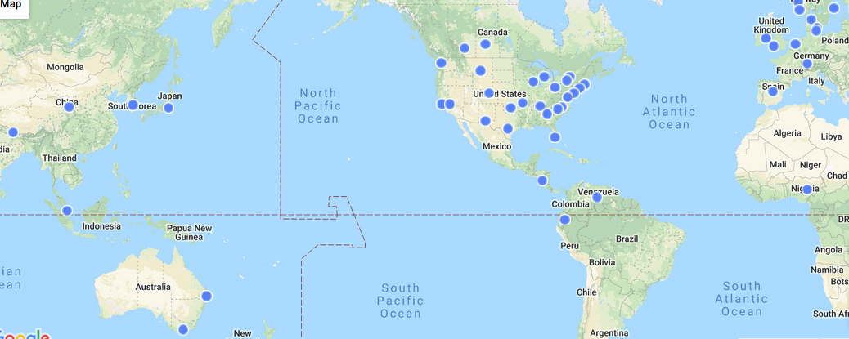
…around the world

Slide 21
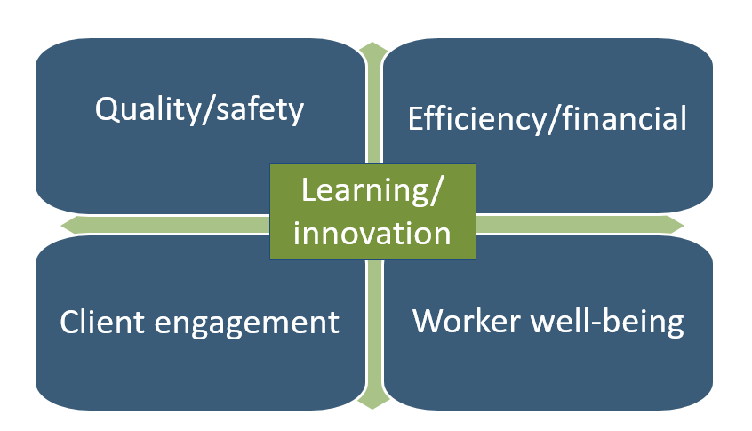
Performance outcomes of RC
Bolton, R., Logan, C., & Gittell, J. H. (2021). Revisiting relational coordination: A systematic review. The Journal of Applied Behavioral Science, 57(3), 290-322.

Slide 22
When does relational coordination matter most?

Slide 23
Relational coordination matters most under conditions of complexity
Task interdependence
Uncertainty
Time sensitivity
Gittell, J. (2002). Coordinating mechanisms in care provider groups: Relational coordination as a mediator and input uncertainty as a moderator of performance effects. Management science, 48(11), 1408-1426.

Slide 24
RC shifts the quality/efficiency frontier to create value
Quality & Safety Outcomes
Relational coordination
Efficiency & Financial Outcomes

Slide 25
There are other useful responses to performance challenges…
Reengineering
Total quality management
PDSA
Quality improvement
Lean/ six sigma
High reliability

Slide 26
Addressing technical issues is necessary - but not sufficient
“We’ve been doing process improvement for several years, and we think we’re on the right track. But we’ve tried a number of tools for process improvement, and they just don’t address the relationship issues that are holding us back.”
- Bob Hendler, Tenet Healthcare Systems
Baker, N. J., Suchman, A., & Rawlins, D. (2016). Hidden in plain view: Barriers to quality improvement. Physician Leadership Journal, 3, 54-7.

Slide 27
How does RC improve
learning and innovation?
Relationships of shared goals,
shared knowledge and mutual respect
promote a culture that supports
process improvement
Deming, W. E. (1986). Out of the Crisis. MIT Press.

Slide 28
How does RC improve
learning and innovation?
Positive relationships evoke positive emotions – activating more advanced part of our brain - thus supporting
learning and innovation
Fredericksen, B. (2004). The broaden-and-build theory of positive emotions. Philosophical Transactions of the Royal Society of Biological Sciences.

Slide 29
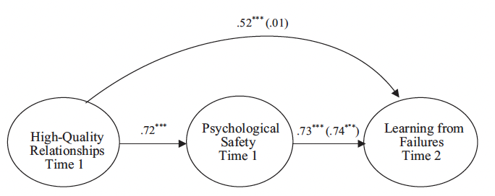
How does RC improve
learning and innovation?
Carmeli, A., & Gittell, J. H. (2009). High‐quality relationships, psychological safety, and learning from failures in work organizations. Journal of Organizational Behavior.

Slide 30
How does RC improve
worker outcomes?
Relational coordination enables workers to achieve better quality outcomes for their clients and customer with
less wasted effort
less stress
therefore less burnout
Gittell, J. H., Weinberg, D., Pfefferle, S., & Bishop, C. (2008). Impact of relational coordination on job satisfaction and quality outcomes: a study of nursing homes. Human Resource Management Journal, 18(2), 154-170.

Slide 31
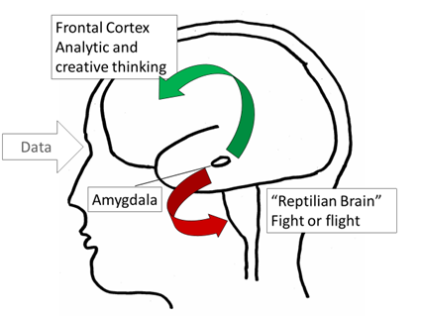
How we communicate and relate affects our brains
for better…
…or worse

Slide 32
We can create positive spirals …
Frequent
Timely
Accurate
Problem-solving communication
Shared goals
Shared knowledge
Mutual respect

Slide 33
… or negative spirals
Infrequent
Delayed
Inaccurate
“Finger-pointing” communication
Competing goals
Exclusive knowledge
Lack of respect

Slide 34
In sum….
Relationships of shared goals,
shared knowledge and mutual respect help people to connect in productive ways around
the work they do together

Slide 35
Patient care:
A coordination challenge
Case Managers
Attending Physicians
Nurses
Physical Therapists
Nursing Assistants
Patients
Social Workers
Technicians
Referring Physicians
Administrators

Slide 36
Building healthy communities:
A coordination challenge
Clients and Families
Employment Counselors
Mental Health Providers
Employers
Substance Use Counselors
Food Security
Primary Care Clinics
Transportation
Hospital
Municipal Government
Housing Support
Community Health Workers

Slide 37
But how do we get from
here to there?
Gittell, J. H. (2016). Transforming relationships for high performance: The power of relational coordination. Stanford University Press.

Slide 38
Relational model of change
Structural Interventions
Select for Teamwork
Train for Teamwork
Relational Job Design
Shared Accountability
Shared Rewards
Shared Conflict Resolution
Boundary Spanner Role
Shared Meetings & Huddles
Shared Protocols
Shared Information Systems
Shared Space
Relational Coordination
Frequent
Timely
Accurate
Problem Solving
Communication
Shared Goals
Shared Knowledge
Mutual Respect
Performance Outcomes
Quality & Safety
Efficiency & Finance
Engagement
Well-Being
Learning & Innovation
Relational Interventions
Map and Measure Relationships
Engage in Humble Inquiry
Create Psychological Safety
Work Process Interventions
Assess Current State
Identify Desired State
Experiment to Close the Gap
Multi-stakeholder team leads the process

Slide 39
Six stages of change
Stage 1: Explore context and create change team
Stage 2: Assess relational coordination
Stage 3: Assess structures
Stage 4: Design interventions
Stage 5: Implement interventions
Stage 6: Assess progress and spread the learning
A cycle of continuous improvement

Slide 40
Three types of interventions
Relational interventions help to strengthen relational coordination
Structural interventions help to support and sustain relational coordination
Work process interventions are participatory problem solving methods for continuous improvement (lean, six sigma, PDSA, improvement science, etc.)

Slide 41
Relational interventions
Relational mapping to see the whole
Humble inquiry to create psychological safety
Top priorities to identify shared goals
Conversations of interdependence to build shared knowledge
Conversations of difference to build shared knowledge
Improvisation to see the perspective of others
Walk a mile to see the perspective of others
Stepping stones to shared personal narratives
Behavioral standards to build mutual respect
Gittell, J. H. (2016). Relational interventions in Transforming relationships for high performance: The power of relational coordination. Stanford University Press.

Slide 42
Relational interventions
“Relational interventions are interventions that improve participants’ capacity to self-manage their interdependence; to understand their common goal, to understand how their work fits into the larger work process, and to carry out their work with a mindfulness of how their actions affect the work of others.”
– Tony Suchman

Slide 43
Relational intervention to build psych safety
Set up the room to signal inclusion
Be attentive to who is invited, why they are invited and your expectations for their participation
Role model positive relational behaviors
Establish behavioral standards
Engage in humble inquiry

Slide 44
Relational intervention to build psych safety
PEARLS
Partnership | We’ll get through this together
Empathy | It sounds like that was difficult for you
Acknowledgement | That was really well done
Respect | I respect that about you
Legitimation | Anyone would feel [happy/disappointed] after going through that
Support | Just know I’m here to help

Slide 45
Relational intervention to build psych safety
Humble inquiry
Express vulnerability by asking questions to which you don’t know the answer
Admit publicly you rely on the expertise of others, thus lowering status barriers based on expertise
“Each of us knows a lot but we can’t possibly know everything - we need diverse perspectives to see the whole picture”

Slide 46
Relational intervention to build psych safety
Relational repair
Are you OK? Did I say the wrong thing? (empathy, humble inquiry)
Reflect back what you hear (reflective listening)
I have a lot to learn (acknowledge)
Propose a follow up action

Slide 47
Relational intervention to build shared goals
Sit around a table or on zoom with all roles in focal work process
Each person writes down top three goals their role has for the work, on sticky notes (real or virtual)
Place in the center, organize by theme
Note common themes, note differences
Any goals that you can all agree on?
Any different goals that you can support?
Any competing goals you will need to resolve, and how?

Slide 48
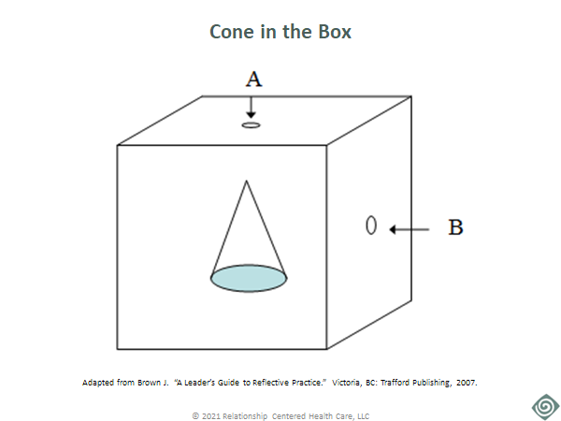
Relational intervention to build shared knowledge
When we include diverse perspectives,
we can see more together

Slide 49
Relational intervention to build shared knowledge
Conversations of interdependence
Find one partner from another role and ask:
What do you find most meaningful about your work?
What it is about how I do my work that helps you do yours?
What could I do differently that would help you more?
Then switch places

Slide 50
Relational intervention to build shared knowledge
Conversations of similarities and differences
Find one partner from a different role and ask:
What are some of the things we have in common? Professionally? Personally?
What are some of our differences? Professionally? Personally?
How might those differences impact how we work together? Positively? Negatively?
How could we use our differences to create more value?
Then switch places

Slide 51
Relational intervention to build mutual respect
Sit around a table or on zoom with all roles in focal work process
Each person writes down three things that help them to feel respected, on sticky notes (real or virtual)
Put them in the center, organize by themes
Note common themes
Note differences
Create behavioral standards for the group, based on the themes

Slide 52
Structural interventions
Select & train for teamwork
Relational job design
Shared accountability
Shared rewards
Shared conflict resolution
Boundary spanner roles
Shared meetings & huddles
Shared protocols
Shared information systems
Shared space
Gittell, J. H. (2016). Structural interventions in Transforming relationships for high performance: The power of relational coordination. Stanford University Press.

Slide 53
Organizational structures assessment tool
Structures | Nurses | Case managers | Physicians | Residents | Physical therapy | Respiratory therapy
Selection for Teamwork
Training for Teamwork
Relational Job Design
Shared Accountability
Shared Rewards
Conflict Resolution
Boundary Spanner Role
Shared Meetings & Huddles
Shared Protocols
Shared Info Systems
Shared Space
WEAK SUPPORT
MODERATE SUPPORT
STRONG SUPPORT

Slide 54
Structural interventions
Which structures are currently most supportive of relational coordination?
Which structures are currently least supportive of relational coordination?
Where are the biggest opportunities for improving your structures?
Where will you start? What obstacles will you face?
Who will you need to engage from within (and possibly outside) the organization?

Slide 55
Work process interventions
Participatory problem solving methods provide an iterative approach to improvement based on experimentation
Total quality management
Quality improvement
Lean/six sigma
High reliability
Improvement science
Gittell, J. H. (2016). Work process interventions. Transforming relationships for high performance: The power of relational coordination. Stanford University Press.

Slide 56
Stage 5: Implement interventions
Be the change (parallel process); you can’t use the old culture to create the new one
Include all relevant stakeholders (some may be less visible)
Use RC to open up conversations, not to close them down
Engage people in doing the work for themselves rather than doing it for them
Developed by Dr. Tony Suchman, Relationship Centered Health Care

Slide 57
Implement interventions
Motivate stakeholders who come from distinct perspectives with different perceived levels of power to contribute time and effort to a change project
Create a psychologically "safe space" for them to disagree respectfully
Facilitate sensitive discussions among them
Take care to avoid using metrics including RC survey results as report cards

Slide 58
Stage 6: Assess progress and spread the learning
Change team assesses progress with periodic assessments of RC, org structures and performance outcomes
Change team spreads the learning through leadership mandate or positive contagion

Slide 59
Assess progress and spread the learning
Relational interventions for organizational learning: An experience report
Introduction: Quality improvement and implementation science practitioners identify relational issues as important obstacles to success. Relational interventions may be important for successful performance improvement and fostering Learning Health Systems.
Methods: This case report describes the experience and lessons learned from implementing a relational approach to organizational change, informed by Relational Coordination Theory, in a health system. Structured interviews were used to obtain qualitative participant feedback. Relational Coordination was measured serially using a validated seven-item survey.
Results: An initial, relational intervention on one unit promoted increased participant engagement, self-efficacy, and motivation that led to the spontaneous, emergent dissemination of relational change, and learning into other parts of the health system. Staff involved in the intervention reported increased systems thinking, enhanced focus on communication and relationships as key drivers for improvement and learning, and greater awareness of organizational change as something co-created by staff and executives.
Thygeson, N. M., Logan, C., Lindberg, C., Potts, J., Suchman, A., Merchant, R., & Thompson, R. (2021). Relational interventions for organizational learning: An experience report. Learning Health Systems, 5(3).

Slide 60
Six stages of change
Stage 1: Explore context and create change team
Stage 2: Assess relational coordination
Stage 3: Assess structures
Stage 4: Design interventions
Stage 5: Implement interventions
Stage 6: Assess progress and spread the learning
A cycle of continuous improvement

Slide 61
Relational model of change
Structural Interventions
Select for Teamwork
Train for Teamwork
Relational Job Design
Shared Accountability
Shared Rewards
Shared Conflict Resolution
Boundary Spanner Role
Shared Meetings & Huddles
Shared Protocols
Shared Information Systems
Shared Space
Relational Coordination
Frequent
Timely
Accurate
Problem Solving
Communication
Shared Goals
Shared Knowledge
Mutual Respect
Performance Outcomes
Quality & Safety
Efficiency & Finance
Engagement
Well-Being
Learning & Innovation
Relational Interventions
Map and Measure Relationships
Engage in Humble Inquiry
Create Psychological Safety
Work Process Interventions
Assess Current State
Identify Desired State
Experiment to Close the Gap
Multi-stakeholder team leads the process

Slide 62
Visit the Relational Coordination Collaborative for more resources and a supportive community

Slide 63
We are witnessing a revolution in people analytics, where data are used to identify and leverage human talent to drive performance outcomes. Today’s workplace is interdependent, and individuals drive performance through networks that span department, organization and sector boundaries. This book shares the relational coordination framework, with a validated scalable analytic tool that has been used successfully across dozens of countries and industries to understand, measure and influence networks of relationships in and across organizations, and which can be applied at any level in the private and public sectors worldwide.
Gittell, J.H. & Ali, H.N. (2021). Relational Analytics: Guidebook for Analysis and Action. Routledge Publishing.

Slide 64
Visit Relational Coordination Analytics for measurement, analytic and reporting support

