Slide 1
Introduction to Disability Rights Law for Parents and Prospective Parents with Disabilities
Robyn M. Powell, M.A., J.D.
Parents Empowering Parents: National Research Center for Parents with Disabilities and their Families

Slide 2
Acknowledgements
Support was provided by the grant #90DP6E0001-01-00, from the National Institute for Disability, Independent Living, and Rehabilitation Research (NIDILRR), US Department of Health and Human Services, and the Lurie Institute for Disability Policy. The opinions and conclusions are solely mine and should not be construed as representing the sponsor.

Slide 3
Legal disclaimer
The information on this webinar is provided for informational purposes and is not intended to be legal advice regarding any specific situation. Any links to third-party websites are provided as a courtesy and are not intended to nor do they constitute an endorsement of the linked materials. The information you obtain on this webinar is not, nor is it intended to be, legal advice. You should consult an attorney for advice regarding your individual situation.

Slide 4
Parents Empowering Parents
Parents Empowering Parents (PEP): National Research Center on Parents with Disabilities and their Families is a cross-disability initiative guided by the ethos of the disability community, “nothing about us without us.”
Through services, research, and advocacy, the Center provides instruction and information about health and parenting services for parents with disabilities and their families.

Slide 5
Training curriculum
Introduction to disability rights law
The rights of parents with disabilities in child welfare and family law
The rights of prospective parents with disabilities in adoption and foster care
Access to reproductive health care for parents and prospective parents with disabilities
www.centerforparentswithdisabilities.org

Slide 6
Learning objectives
Learn about the Rehabilitation Act and the Americans with Disabilities Act
Define disability under the Rehabilitation Act and the Americans with Disabilities Act
Describe how disability rights laws relate to parenting with a disability

Slide 7
Rehabilitation Act of 1973
The Rehabilitation Act prohibits discrimination on the basis of disability in programs conducted by Federal agencies, in programs receiving Federal financial assistance, in Federal employment, and in the employment practices of Federal contractors
The standards for determining employment discrimination under the Rehabilitation Act are the same as those used in title I of the Americans with Disabilities Act

Slide 8
Section 504
Applies to:
Almost all public school districts
Public and most private colleges and universities
Health and social services, programs
Public housing authorities, cities and towns that receive Community Development Block Grants (CDBG) or other federal funds, private for profit or non-profit housing developers, and student housing
Transportation services
Applies to the Corporation for National Service

Slide 9

Americans with Disabilities Act (“ADA”)
Signed into law by President George H.W. Bush on July 26, 1990

Slide 10
Who is a person with a disability under ADA and Section 504?
Three ways to meet definition:
Physical or mental impairment that substantially limits one or more major life activities or major bodily functions;
A record of such an impairment; OR
(e.g., history of heart disease)
Being regarded as having such an impairment
(e.g., employer fires employee after rumor of HIV, although it didn't substantially limit)

Slide 11
Association
Prohibits discrimination based on someone’s association with a person with a disability

Slide 12
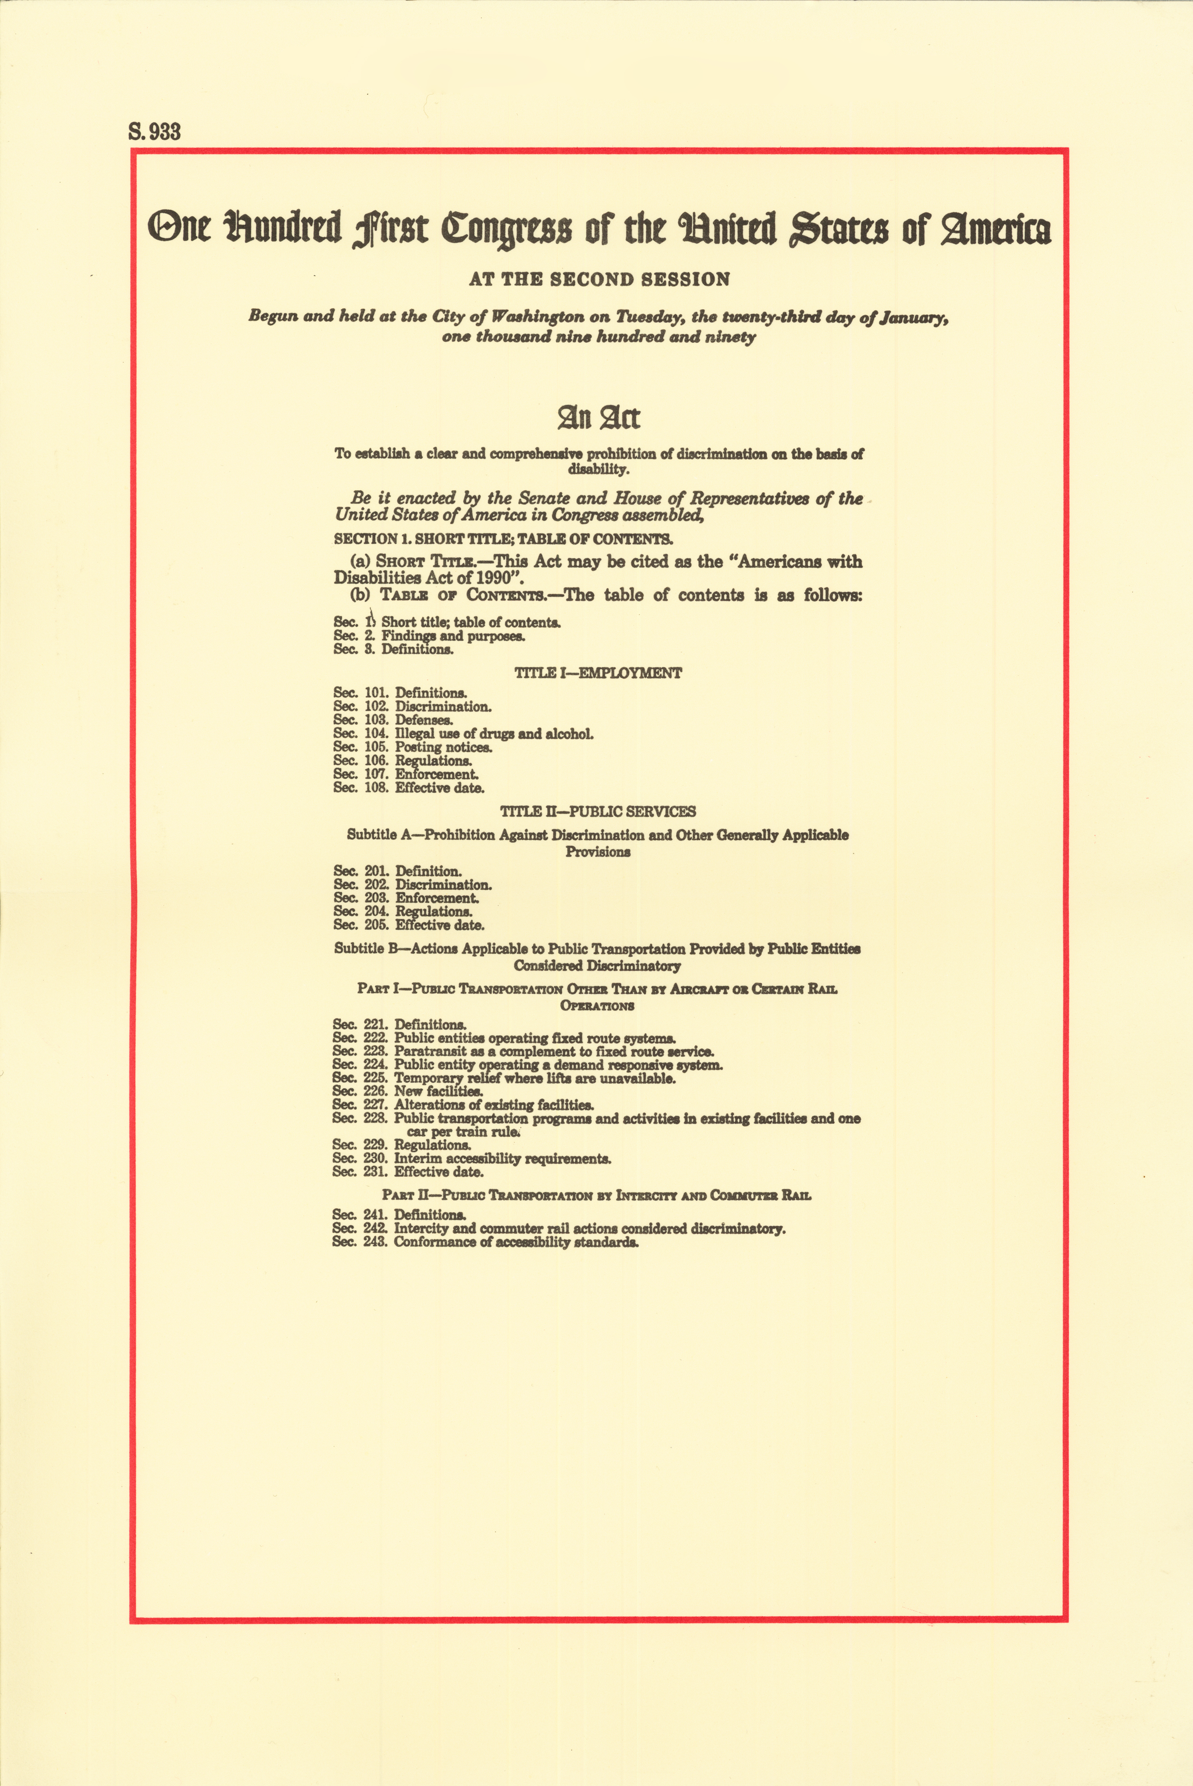
ADA
Title I – Employment
Title II – Public entities (i.e., state and local government); public transportation provided by public entities (e.g., MBTA)
Title III – Public accommodations; commercial facilities; examinations & courses related to licensing or certification; transportation provided to the public by private entities
Title IV – Telecommunications
Title V – Miscellaneous provisions (e.g., attorneys fees; enforcement)

Slide 13
Non-discrimination requirements
Integration
Equal opportunity
Eligibility criteria
Reasonable modifications
Effective communication
Physical access
Note: cannot charge or impose additional requirements

Slide 14
Exceptions/defenses
Fundamental alteration
Undue financial and administrative burdens
Direct threat
Legitimate safety requirements

Slide 15
Disability rights and parenting
Disability rights laws apply to all aspects of parenting with a disability!
Child welfare system
Family law system
Adoption and foster care
Health care
Education
Work
Playgrounds
Restaurants
Sporting events
Concerts
Etc.

Slide 16
Enforcement of disability rights laws
Title I: Employment
U.S. Equal Employment Opportunity Commission (EEOC) www.eeoc.gov
Title II: Public Entities (State & Local Governments)
U.S. Department of Justice (DOJ) Disability Rights Section (in conjunction with other designated federal agencies) www.ada.gov
Title III: Public Accommodations (Private Businesses)
U.S. Department of Justice (DOJ) Disability Rights Section (in conjunction with other designated federal agencies) www.ada.gov
Title IV: Telecommunications
Federal Communications Commission (FCC) www.consumercomplaints.fcc.gov/hc/en-us
Title V: Miscellaneous Provisions
Enforced by the agencies responsible for each title

Slide 17
Additional resources and tools
Protection and Advocacy organizations www.ndrn.org
ADA National Network www.adata.org
Department of Justice www.ada.gov

Slide 18
THANK YOU!
Robyn M. Powell
rpowell@brandeis.edu
www.centerforparentswithdisabilities.org

