Slide 1


Strategies for supporting parents with disabilities when there is child welfare involvement
Drs. Liz Lightfoot and Kara Ayers
January 30, 2025
Notes:
Thank you all for coming we’ll get started in just a minute. My name is…. I am also a parent with a disability.

Slide 2
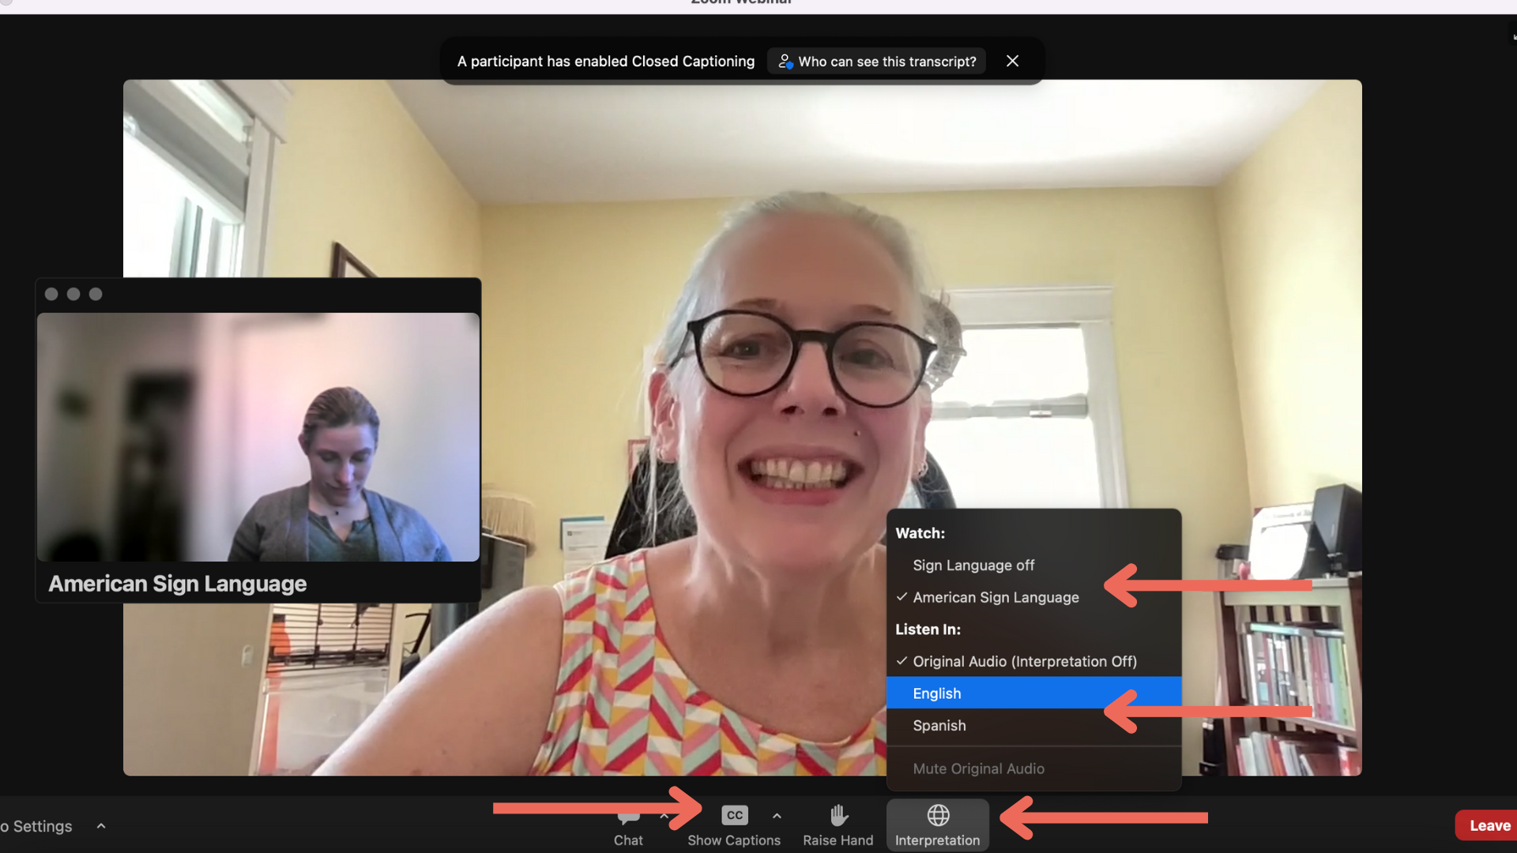
Closed Captioning and ASL

Slide 3

Funding
  The contents of this presentation were developed under a grant from the National Institute on Disability, Independent Living, and Rehabilitation Research (NIDILRR grant number 90DPCP0012). NIDILRR is a Center within the Administration for Community Living (ACL), Department of Health and Human Services (HHS). The content is solely the responsibility of the authors and does not necessarily represent the official views of NIDILRR, ACL, or HHS.
Notes:
Th

Slide 4
Resources
National Research Center for Parents with Disabilities http://heller.brandeis.edu/parents-with-disabilities/index.html
Disabled Parenting Project https://www.disabledparenting.com/
Rocking the Cradle: Ensuring the Rights of Parents with Disabilities and their Families https://ncd.gov/publications/2012/Sep272012
Child Welfare Information Gateway https://www.childwelfare.gov/
The Association for Successful Parenting (TASP) http://achancetoparent.net/
Children of Parents with a Mental Illness http://www.copmi.net.au/
Bazelon http://www.bazelon.org/our-work/mental-health-systems/parental-rights/

Slide 5






Learn More/Contact Us
@NatRCPD @LurieInstitute
facebook.com/LurieInstitute
lurie.brandeis.edu
nicolelomerson@brandeis.edu

Slide 6

Strategies for Supporting Parents when there is Child Protection Involvement
Elizabeth (Liz) Lightfoot
School of Social Work
Arizona State University

Slide 7


Agenda
History, Policy & Research
Some Concepts
Some Resources

Slide 8
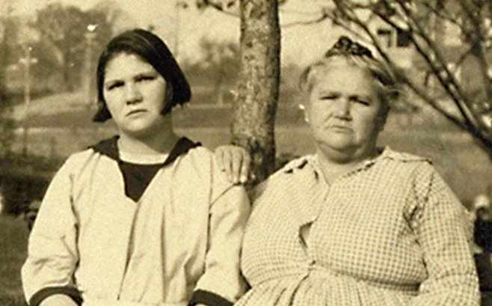
Photo of Carrie Buck and her mother.
Notes:
In the early twentieth century in the US, people with disabilities were routinely sterilized involuntarily
This practice was formalized into state law. The first state law allowing involuntary sterilization of parent swith disabilities was passed in 1907 in Indiana, and a number of states followed suit, culminating with VA in 1924.
This led to a famous Supreme Court case – Buck vs. Bell, in 1927. This is a photo of Carrie Buck, on the left, aner mother. The Supreme Court ruled that it was constitutional to involuntarily sterilize the “unfit”.
Oliver Wendell holmes, in support of his argument that the the interest of "public welfare" outweighs the interest of individuals in their bodily integrity, he argued:
"Three generations of imbeciles are enough".^{[14]}
In the decade that followed 1927, there were 28,000 people sterilized against their will, including 8,000 in VA alone
This practice generally withered out, though it morphed into a common practice of mothers with disabilities having their babies removed at birth, based on their disability.
This still happens today.

Slide 9

What do we know?
Parents with disabilities are MUCH more likely to:
be reported for child abuse and neglect
have abuse substantiated
have their children placed in foster care
have their rights terminated
Child protection workers get little training on supporting parents with disabilities
There are few services and supports for parents with disabilities
Notes:
Find additional images to use for this slide
11% of parents have a disability (6.9 million)
30% of adults with disabilities have a child living at home
Types of Disabilities (underestimate)
Roughly 1 million parents had mental illness
Roughly 250 thousand parents had intellectual or developmental disabilities
In the US, most state child welfare organization do not collect parental disability data
National data collection system (NCANDS) collects parental disability on states who HAVE it identified
The National Child Abuse and Neglect Data System (NCANDS) is a voluntary data collection system that gathers information from all 50 states, the District of Columbia, and Puerto Rico about reports of child abuse and neglect.
The Adoption and Foster Care Analysis and Reporting System (AFCARS) collects case-level information on all children in foster and children who have been adopted with title IV-E agency involvement

Slide 10

Some policies related to parents with disabilities
State
State Child Welfare and Family Policies
Federal
Americans with Disabilities Act
DHHS/DOJ Joint Guidance
Sec 504 of Rehab Act (new 2024 rules!)
Medicaid?

Slide 11
State Child Protection Statutes
Ariz. Rev. Stat. § 8-533 (2022)
B. Evidence sufficient to justify the termination of the parent-child relationship shall include any one of the following, and in considering any of the following grounds, the court shall also consider the best interests of the child:
3. That the parent is unable to discharge parental responsibilities because of mental illness, mental deficiency or a history of chronic abuse of dangerous drugs, controlled substances or alcohol and there are reasonable grounds to believe that the condition will continue for a prolonged indeterminate period.

Slide 12
Parents’ Rights DIFFER by STATE --- Some Examples from Arizona
During Initial Contact
Refuse to cooperate or receive services
Deny entry into home
Have attorney present during questioning
Respond to allegations AND have this considered
Refuse to sign release of information, submit to mental health evaluation (unless court ordered)
To appeal
To report violation of rights
If Child is Placed Out of the Home
Be notified about the reasoning for removal
Receive services aimed at family reunification
Be notified of date, time, location of all hearings
Maintain contact with your child (unless determined it will affect safety and well-being)
Be consulted about your child’s medical care, education, grooming
Have attorney present at all court proceedings
To report violation of rights
Example: A.R.S. 8-809.01

Slide 13
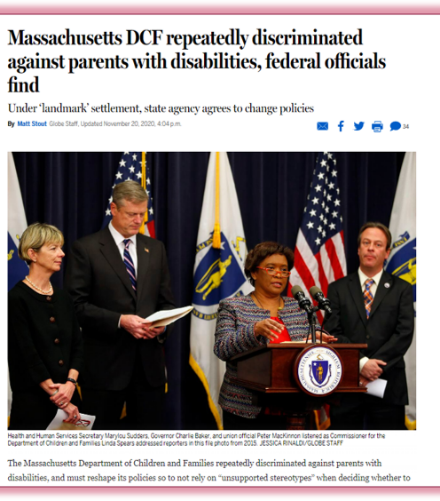
US Department of Health and Human Services and US Department of Justice Released a Joint Guidance (2015)
Notes:
In 2015, The federal Department of Justice and the federal Department of Health and Human Services issued a technical assistance guidance describing how child welfare agencies and courts must protect the rights of parents with disabilities. The DOJ/DHHS TA Guidance requires child welfare and court services to not discriminate against parents with disabilities in any of its services, including in investigations, provision of parent training or other services, and important decisions, such as decisions to remove a child from the home or allow for visitation. The DOJ/DHHS TA Guidance requires child welfare agencies and courts to treat parents with disabilities on an individualized basis and make decisions on individualized assessments, rather than generalizations or stereotypes. In addition, services provided must allow for full and equal opportunity for parents with disabilities to participate in child welfare services, and might require the provision of different benefits and services, adapted services, or auxiliary aids. https://archive.ada.gov/doj_hhs_ta/child_welfare_ta.html

Slide 14
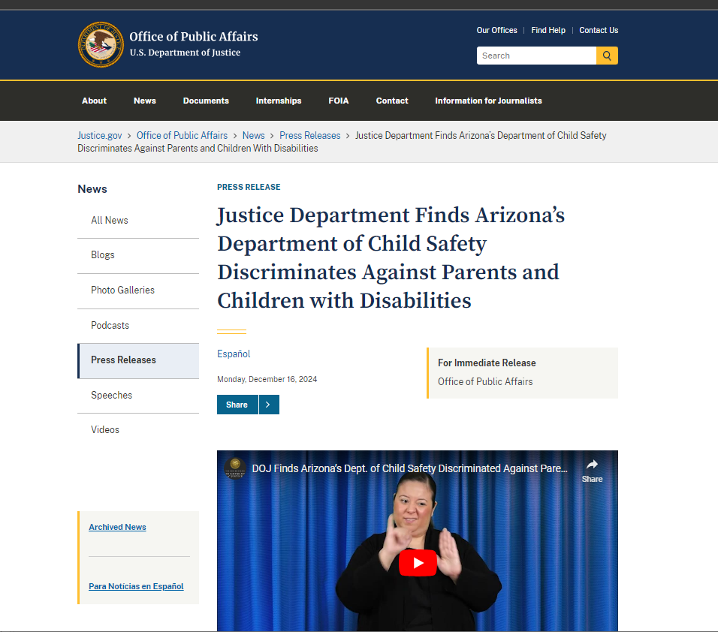
DOJ’s Most Recent Finding
December 14, 2024

Slide 15
A Few Concepts
Notes:
There are eight core concepts and frameworks that can help social service workers provide support for parents with disabilities. Understanding these concepts and frameworks can help ensure that parents with disabilities and their families have the best possible outcome

Slide 16
Concepts
Parental Supports
Parental Risk Factors ≠ Child Endangerment
“Good Enough” Parenting Standard
Presumption of Unfitness Bias
Notes:
Find additional icons for this slide

Slide 17
Parental Supports
Supports in general are technologies or personal supports to enhance individual functioning (AAIDD)
Adaptive Equipment
Adaptive Crib
Smart Phone Apps
Technologies
Parental Supports
Enhance
FAMILY Functioning
Any support designed to assist parents with a disability to parent
Day care/Respite
Homework
In home training
Personal Supports
Notes:
Parental supports are personal supports or technologies that can assist parents in raising their children. Nearly all parents use formal or informal supports for parenting their children, such as sending their children to daycare while they work or having relatives assist them with their children. Parents with disabilities might need some different kinds of assistance, such as in-home parent training, parenting assistance, or safety planning. Some might need technologies to assist with parenting, such as phone applications that assist with parenting tasks, adaptive baby carriers or strollers, or an adaptive baby monitor. The concept of supported parenting, which focuses on parenting with parental supports, differs from the conventional child protection approach that expects parents to parent their child independently. When assessing parents with disabilities, it is important to evaluate how parents can effectively parent with appropriate parental supports.
Parental supports for parenting activities for persons with intellectual and developmental disabilities
can be defined similarly to the general notion of supports developed by AAIDD. As supports
in general for this population are thougtt to be technologies or personal supports that enhance
individual functioning (Schalock et al., 2010), parental supports are simply technologies or personal
supports that enhance family functioning in families headed by a parent or guardian with a
disability.
Technology can include any adaptive equipment that that may assist an individual in parenting, such as adaptive cribs or child care equipment, cooking/feeding equipment, or a smart phone or personal digital assistant that presents
step-by-step guidelines for parenting activities.
Personal supports include any support designed to assist parents or guardians with a disability to compensate for those aspects of their disability that affect their ability to care for their child or children and will enable them to fulfill their parenting responsibilities. These types of personal supports could include day care services, respite care, a coparent or parent mentor, in-home parenting training, money management assistance, homework tutoring, housekeeping, safety planning, or even longterm family foster care. Similar to the general notion that supports help individuals with disabilities fill
the gaps between their own competencies and environmental demands (Schalock et al., 2010), parental
supports are designed to help individuals with disabilities fill their gaps in parenting competencies
and environmental demands related to parenting.

Slide 18

Three Concepts Applied Differently to Disabled Parents
Parental risk factors do not CAUSE child endangerment
“Good enough” parenting standard
“Presumption of Unfitness” Bias
Notes:
Parental Risk Factors Do Not Cause Child Endangerment. There are numerous risk factors that have been associated with child abuse and neglect. But, risk factors are not deterministic. Risk factors are simply statistical associations. Risk factors cannot predict when an individual parent will endanger their child. For example, parents who are young, parents with low levels of education, or parents who experienced abuse as a child are more likely to abuse or neglect their children. While being a young parent is a risk factor for child abuse or neglect, most young parents do not abuse or neglect their children. For young parents who do abuse or neglect their children, their age is not directly causing the abuse or neglect. This is the same for parents with disabilities. While parents with some types of disabilities might be at a higher risk for child abuse or neglect, most parents with disabilities do not abuse or neglect their children. In fact, for parents with disabilities, other risk factors than their disability are more highly associated with their likelihood to abuse or neglect their children, such as educational levels, their own experiences of abuse or neglect, or poverty.
Good Enough Parenting Standard. While most parents want to be great parents and want the best for their children, there are no perfect parents. When child protection agencies assess parenting capacity, they do not assess whether a parent is a perfect parent, rather they assess whether they are a good enough parent. A good enough parent can meet their child’s basic needs and keep them safe. This concept of the “good enough parent” was originally developed by Donald Winnicott, a British psychiatrist, in the 1950s, when he found that children actually benefit when their parents are not perfect. When working with parents with disabilities, it is important to use the same good enough parenting standard as is used with other parents, rather than holding them to a higher standard. In addition, when parents with disabilities are assessed as to their parenting capacity, they should be able to demonstrate how they can be good enough parents with appropriate support.
Presumption of Unfitness Bias. There are widespread biases against parents with disabilities about their unfitness to parent. The nature of this bias varies based on the type of disability. There is no evidence that parents with any type of disability are unable to parent because of their disability. This bias can lead to parents with disabilities being dissuaded from becoming parents, referred more often to child protection social service providers, assessed as unfit to parent based on their disability rather than their ability to parent, and losing their children more often in child protection and child custody proceedings.

Slide 19


  Some “Evidence”
Social Support Interventions
Parenting Skills

Slide 20
Strengths Approach
Provide Individually Tailored Services
Parents as Experts and Decision-Makers
Use Appropriate Communication
Understand Trauma Associated with Presumption of Unfitness Bias
Collaborate and Consult
Expand Understanding of Disabilities
Practice with Cultural Sensitivity
Make Sure Your Services are Accessible
Build Parenting Skills
Facilitate Social Support Networks
Support in Legal Advocacy
Seek Out Resources on Parenting with a Disability
Be accessible!!!

Slide 21



Some Resources
Notes:
Find additional images to use for this slide
Here – just read the paper….

Slide 22

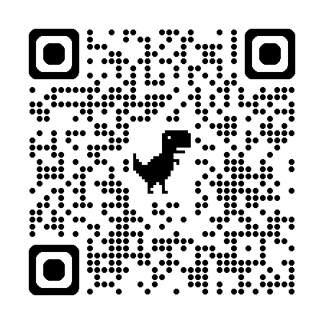
Details about New Law
User Friendly Guide
Notes:
Find additional images to use for this slide
Here – just read the paper….

Slide 23

Thank you

Slide 24

Strategies for Supporting Parents with Disabilities when there is Child Protection Services Involvement
Kara Ayers, PhD
kara.ayers@cchmc.org

Slide 25

Kara Ayers, PhD
  Professor and researcher
  Trained as a clinical psychologist
  Disabled Parenting Project
  National Research Center for Parents with Disabilities
  National Center for Disability and Pregnancy Research
  No disclosures for this talk

Slide 26

Happy family in the woods; 2 family members are in a wheelchair.

Slide 27

Case study of a disabled parent (“Lena”) reported to CPS by a nurse

Slide 28
Lena’s Story 1
Lena has a physical disability. She is a wheelchair user. She lives with her partner and their 2-year-old child. Lena has her graduate degree and works full-time in her field. Her partner also works full-time. Their childcare provider watches their child 4 days a week in her home.
Lena requested an evaluation from the state to determine if she was eligible for in-home nursing services following recovery from a surgery.
The nurse conducting her evaluation arrived at the home hours after Lena had returned from the hospital where she’d had surgery earlier that day. Lena’s partner had taken their child outside the home during the evaluation.

Slide 29
Lena’s Story 2
3 days after the evaluation, Lena received a call from CPS stating there was a report of suspected child neglect. She was asked to schedule an in-home evaluation to take place 5 days later
A CPS worker arrived at the home for the evaluation and conducted a 50 minute interview, inspecting medicine cabinets, refrigerators, pantries, and living spaces. He requested access to medical records since birth and contact information to interview the family’s childcare provider.

Slide 30
Lena’s Story 3
Lena had invited an advocate to be present for the evaluation and it was recorded. She checked with the advocate on her rights to refuse access to medical records and whether she had the right to refuse access to the childcare provider.
The evaluator asked Lena multiple questions about whether she was ever alone with her child as well as, “Is (the child) adopted?” followed by, “If you don’t mind me asking, how did you have (the child)?”
Lena allowed the evaluator to speak to her parents but not the childcare provider. She also denied access to medical records.

Slide 31
MICROAGGRESSIONS EXPERIENCED
BY DISABLED PARENTS
Adapted from Disability Affirmative Therapy by Rhoda Olkin (2017)
Type | Description | Example
Invasion of privacy | People may invade personal space and ask personal questions because you have a disability. | "What happened to you?" "Oh here let me pick her up for you." (Picking up child without asking.)
Helplessness | People may frantically try to help and treat you like a child. | "Oh let me do that for you!" Running to open doors.
Patronization | People praising you for almost anything and finding it surprising you do ordinary things. | "It is so good to see you out and about!"
Denial of disability | Disability is ignored-or claimed to be ignored. | "I don't even think of you as having a disability"
Questioning our children | People may ask children personal questions about their parents or how their family works. | "You are so kind to help your parents." "Who takes out the trash in your house?"

Slide 32
Lena’s Story 4
One week after the in-home evaluation, Lena received a phone call that her case was closed and there would be no permanent record the investigation had taken place. Two weeks after the evaluation, she received a letter in the mail confirming this decision.
Lena was denied the in-home nursing care she’d requested without explanation. She has appealed the decision.

Slide 33

What questions does Lena’s story bring up for you?
Notes:
While I can't answer all of your questions, I'm interested in what types of questions Lena's story brings up for you as we think about this challenge-the involvement of CPS in the lives of parents with disabilities.
Here are some questions her case brings up for me:
-There are a few standards that reports of child neglect or abuse are supposed to meet to be passed on to the next stage and actually investigated. How did the report about Lena ever advance to be investigated when her child was not in the home at the time the nurse (who reported) was present? It was impossible for the nurse to have observed any type of parenting. There were not reports of an unsafe environment. It seems this case-and many like it-was entirely based on assumptions about whether or not or how a disabled parent can, cannot, or should not parent?
-Lena's case taught us about how difficult it is to clarify our rights once CPS is involved. We had to check with multiple people to find out whether we could record, she could have an advocate present, what she could refuse, etc.
-It felt like coercion at times that it was suggested as long as Lena agreed not to be alone with her child, then all parties would be in agreement.

Slide 34
The impact of ableism

Slide 35

ABLEISM
A WORKING DEFINITION BY T.L. LEWIS
A system that places value on people's bodies and minds based on societally constructed ideas of normalcy, intelligence, excellence, and productivity. These constructed ideas are deeply rooted in anti-Blackness, eugenics, colonialism, and capitalism.
This form of systemic oppression leads to people and society determining who is valuable and worthy based on a person's appearance and/or their ability to satisfactorily (re)produce, excel, and "behave."
You do not have to be disabled to experience ableism.

Slide 36
YOU DO NOT HAVE TO BE DISABLED TO EXPERIENCE ABLEISM.

Slide 37
CPS “standards for what constitutes an appropriate level of childcare is set by what white middle class (nondisabled) families with more economic resources. Poverty and racial bias are bigger factors....than actual safety concerns or abuse.”
Findings from an ACS (New York CPS) commissioned National Innovation Service (NIS) report from an internal audit. New York CPS didn’t make the report public but it was obtained by a Freedom of Information Act (FOIA) request.

Slide 38
Parental rights when child protective services is involved

Slide 39

Disabled parents have rights* that include:
  the right to refuse entry into your home without a court order.
  the right not to speak to a CPS worker without an attorney present or without a court order
  the right to withhold consent for a release of medical records
  the ability to record child welfare interviews
*may vary state to state

Slide 40

Family Miranda Laws
  Texas (passed)
  New York (not yet passed but introduced)

Slide 41

Andrew Brown, Texas Public Policy Foundation
“These aren’t really new rights created, these are rights that families already have had. It’s a matter of taking the extra step to notify them.”
Notes:
-bipartisan reform effort has increased awareness of parental rights because many advocates have pointed out that the difficulty in finding clarity about what rights you have is intentional.
-An example is in implied consent. So if I'm a CPS worker and I come to your home, knock and say, "Hi. I'm from Child Protective Services. We've had a complaint and I need to come in......"
You say, "Uhhh ok....."
The system views this as consent but it is not informed as that person likely doesn't

Slide 42
Areas for ongoing advocacy to support disabled parents who are targeted by child protective services
Notes:
It's interesting to explore discussions around supporting parents involved in CPS to know their rights. Many parents who receive a CPS complaint feel such deep fear and shame that they don't know what to do or who to tell. Increasingly, advocates are joining to call out these systemic injustices-some call the system itself not "child protective" but "family policing". To understand how the system has been able to perpetuate so much injustice we have to understand how most think of it....

Slide 43

The myth of benevolence
Myth: The system is helping children in need.:
Myth: The system takes children away
because parents are unfit.
Myth: Foster homes are loving and
safe environments.
Notes:
These myths together are used to justify systemic practices.

Slide 44
Countering the myth of benevolence
by understanding:
There is significant harm in
separating families.
Case workers should not conflate a lack of
awareness of disabled parenting with
safety concerns.
Mandated reporting is not required for
hypothetical concerns or curiosities.
Notes:
These myths together are used to justify systemic practices.
I'd also add to this list that curiosity of a case worker should be identified as distinct from what they ask as part of a standardized evaluation. The case worker who interviewed Lena started several questions with, "And I ask this just because I'm curious...." This is not acceptable. Someone's curiosity about a person's disability does not merit garnering more information than typical from an evaluation that can be used against that person.

Slide 45
Enhancing data protections
Data protections to stop entrapment in systems. People may seek a service and not know that they are being recorded and that information could be used against them.
Data collected is being used in predictive ways to “guess” who’s at most risk for abusing or neglecting their children. We know these models are trained on biased data.
It should be easier (or possible) for parents and communities to access the data they need.

Slide 46

Countering “domestic asymmetrical warfare”
Lack of transparency in systems means disabled parents and their families are at greater risk of separation.
Families are not always provided an attorney, and when they are, they often lack experience with or knowledge of disabled parents.
Imbalances in power, resources available, connections, and the weaponization of fear
Rodríguez, D., & Pendleton, M. (Hosts). Reforms don't work [Audio podcast episode]. The UpEnd Pocast. UpEnd Movement.https://upendmovement.org/episode1-6/

Slide 47

Peer supports are helpful for many parents with disabilities.
Online and in-person groups can provide emotional support to parents with disabilities.
Peers frequently share practical strategies that worked for their family while parenting children at different ages.
Advocacy and empowerment: Many laws to protect the rights of parents with disabilities have been spearheaded by groups of disabled parents.

Slide 48


Key Takeaways
Parents with disabilities have rights but it can be difficult to know what they are.
Massive imbalances in the system leave families at risk of separation due to biased beliefs, data, and practices.
Policy changes, including Family Miranda rights, aim to reform systems. Are reforms enough?
The myth of benevolence is a powerful tool used to separate families.

Slide 49





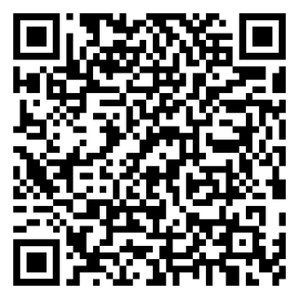
How you can reach me:
kara.ayers@cchmc.org
@DrKaraAyers
@KaraAyers
My Google Scholar Profile to read my work.

Slide 50

Q & A

