Slide 1



Keeping Families Together Training #2
Using Disability Law To Defend Disabled Parents
Kavya Parthiban, JD

Slide 2

Our Speaker
Kavya Parthiban
Disability Rights Education and Defense Fund

Slide 3

Facilitator
Linda Long-Bellil, PhD, JD, Assistant Professor, E.K. Shriver Center and Department of Family Medicine & Community Health, UMass Chan Medical School

Slide 4
Welcome!
Overview
Closed Captioning
Questions in Chat
Resources
Recording
Your Feedback
Survey

Slide 5
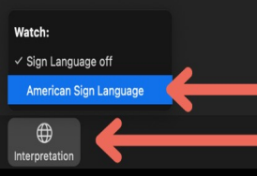
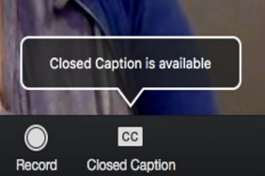
Accessibility
Notes:
Hover over the middle of the screen divider and pull to the left to make the video images larger

Slide 6
Presentation Overview
Working with Parents
Fundamental Principles
Working with the Other Side
Filing a Complaint

Slide 7
Ableism in Dependency
Although only 1 in 10 children in the US have a parent with a disability, children of parents with disabilities make up 19% of the youth in foster care ¹
Removal rates can be as high as 80% for parents with intellectual, cognitive, developmental, or psychiatric disabilities ²
  Assumption of parental unfitness because these parents may understand, communicate, or parent differently than nondisabled people
Yet high-quality studies show that disability is not predictive of abuse or neglect ³
¹ Robyn Powell, Justice for Parents with Disabilities and Their Children, The Regulatory Review, at https://www.theregreview.org/2021/10/26/powell-justice-for-parents-with-disabilities/#:~:text=The%20disproportionate%20rate%20of%20child,the%20children%20in%20foster%20care (Oct 26, 2021)
²Loran B. Kundra and Leslie B. Alexander, Termination of Parental Rights Proceedings: Legal Considerations and Practical Strategies for Parents with Psychiatric Disabilities and the Practitioners Who Serve Them, Psychiatric Rehabilitation Journal 33(2) (2009): 144–145; National Council on Disability (“NCD”), Rocking the cradle: Ensuring the rights of parents with disabilities, https://heller.brandeis.edu/parents-with-disabilities/pdfs/rocking-the-cradle.pdf (2012)
³ National Council on Disability (“NCD”), Rocking the cradle: Ensuring the rights of parents with disabilities https://heller.brandeis.edu/parents-with-disabilities/pdfs/rocking-the-cradle.pdf (2012)

Slide 8

Capacity and Ability to Parent
Capacity is a spectrum – not yes/no question
  Changes with context, topic, emotional & physical state, etc
Capacity is changeable and can be strengthened
Children who live with parents with disabilities can and do thrive, especially when parental capacity is strengthened with accommodations
Reminder: Capacity for representation does NOT require a client to fully understand all nuances of litigation

Slide 9
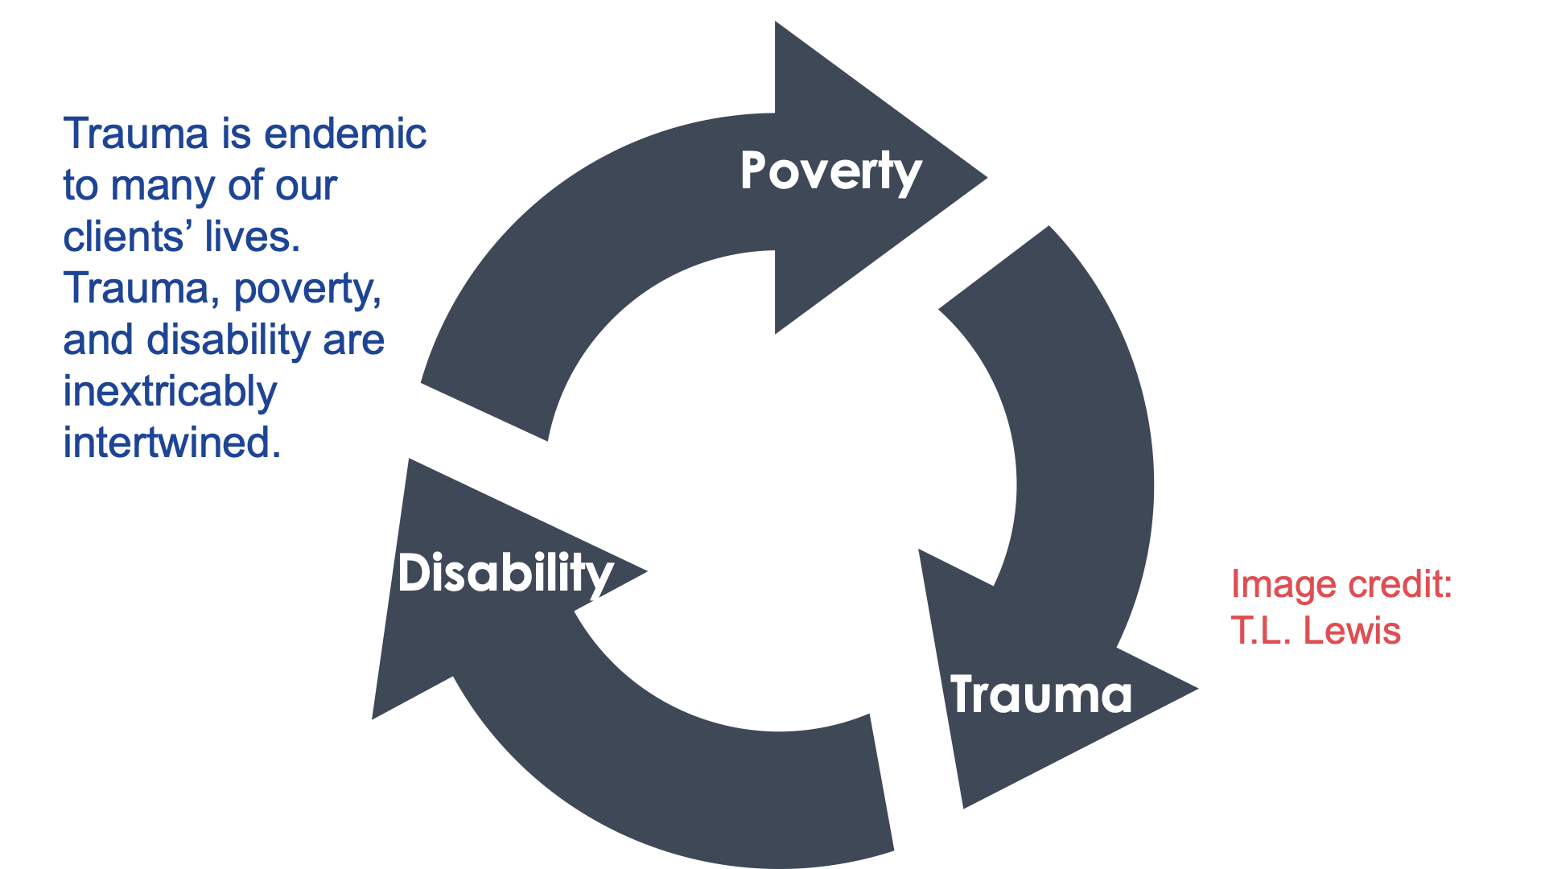

Slide 10
Working with Parents

Slide 11

Accommodations
Comic by Liz Climo

Slide 12
Accommodations
Representing a parent with a disability may require accommodations in a variety of contexts
    Reunification services/case plan
    Court proceedings
    Legal representation
Aim to identify and meet the accommodation needs for each context

Slide 13
Readily Accessible Lawyering
Make your default practices accessible for a wide range of clients
Employ practices regardless of whether client known to have a disability
What does this look like?
  Plain language, avoid legalese
  Make the implicit explicit – don’t assume background knowledge
  Humility, curiosity, attentiveness to clients
  Trauma awareness
  Try to be knowledgeable and ready to make changes to serve people with specific disabilities:
    People who are deaf or hard of hearing
    People who are blind
    People who use wheelchairs
    People with limited speech
  Ask what works and listen
    What accommodations have you had in the past?
  Be prepared to implement common accommodations – learn the basics
  Address disability in a respectful manner

Slide 14
Talking to Clients about Disabilities
Clarify that your focus is not on assigning labels to or judging your clients
The goal is to figure out what is needed for effective representation and ensuring accessibility in the case plan and reunification services.

Slide 15
Talking to Clients about Disabilities (Cont.)
Be straightforward and concrete.
  Most people with disabilities (whether or not they self-identify as disabled) view their disabilities as an everyday part of their lives. Not horrible or shameful, not “triggering” or embarrassing.
  The less apologetic and uncomfortable you are, the better.
Try: “Do you have any mental illnesses or conditions like PTSD, depression, or bipolar disorder?”
Avoid: “I’m really sorry to be asking but would you mind, if it's ok, if I ask, if you don’t mind me asking, if you have ever been diagnosed with any mental illness?”

Slide 16
Talking to Clients about Disabilities (Cont.)
Ask about disability accommodations in simple, nonjudgmental way:
  Is there anything I can do to help us communicate clearly or help you access this meeting fully?
  Sometimes people have trouble keeping track of dates and times for meetings – would it be helpful if I send you a text reminder the day before we meet?
  Would you like to follow along with these notes and charts I am making?
Listen to what the person says! They usually know what works
But some people have not had a chance to get good accommodations, so take “I’m not sure” seriously and try to brainstorm solutions

Slide 17
What if your client disagrees with a disability label?
Some clients do not self-identify as disabled. Some people may disagree with their specific diagnosis. Certain mental disabilities may also prevent a client from having the insight necessary to understand that they are disabled.
What you can do
  Ask them what feels like a more accurate representation of their needs/experience
  Remind them that disability is the “elephant in the courtroom” and having a response to the Agency’s characterization is important for their advocacy

Slide 18
Plain Language
Simple, plain language is “readily accessible lawyering”
Helps people with disabilities and everyone else
  Beneficial for people who have trauma, information overload, drug or alcohol withdrawal, limited formal education, in great transition, etc (i.e. many clients, regardless of disability)
Avoid legalese!
  Can also help reduce power disparities between you and your client
Attempt to communicate at around a 4th to 5th grade level
  Hemmingway
Use an online readability checker to assess the reading level of your written communications

Slide 19
Plain Language (cont.)
Plain language unpacks and explains implied knowledge, using clear, common words.
Instead of: “This case is seeking injunctive relief only.”
Try: In some kinds of lawsuits people are asking for money because something unfair happened to them.
But in this case, we are not asking for money. We are just asking for changes in the jail to protect people.
We will not ask you for money, but we want to make sure you understand that you won’t get any money from this kind of case.

Slide 20

Disability Language Guidance
In representing parents with disabilities,
advocates may need to communicate orally
and in writing about disability.
Because language is constantly evolving,
here are some general guidelines regarding disability language

Slide 21
Disability Language Guidance (Cont.)
Outdated words to avoid:
Handicap Handicapped
Retarded, Slow
Try instead:
Disability, Disabled
Intellectual Disability
Avoid: Defining someone by their disability
  Wheelchair-bound, confined to a wheelchair, wheelchair person
  Paraplegic
  Schizophrenic
Try instead:
  Uses a Wheelchair
  Has Paraplegia
  Has Schizophrenia
        Exceptions
                Blind
                Deaf

Slide 22
Disability Language Guidance (Cont.)
Avoid: language of suffering
Suffers from bipolar disorder
Afflicted with Multiple Sclerosis
Struggles with depression
Try instead:
  Has major depression
  Has cancer
Avoid: euphemisms and imprecise terminology
  Special needs
  Differently-abled
  Mental health issues
Try instead:
  Stating the specific disability

Slide 23
Disability Language Guidance (Cont.)
Avoid: references to mental age
  Has the mind of a 6 year old
  Has the mental ability of a 12 year old
Try instead: stating the specific disability, functional difficulty, or need for accommodation
  Lisa has a learning disability
  Lisa has limited reading proficiency
  Lisa needs written instructions in plain language with bullet points accompanied with oral explanations

Slide 24
Identifying Parents with Disabilities
Screen every client for disability
  Did you have an IEP in school?
  Do you receive SSI or SSDI?
  Do you have trouble learning new things?
  Do you use pain medication on a regular basis?
  Are you able to work? If not, why?
  Are you able to walk up stairs?
  Ask specifically about the allegations against them – even if they aren’t true

Slide 25


Pros & Cons of Disclosing Disability

Slide 26
Connecting Parents with Services
Connect the parent with appropriate disability services that can provide assistance with housing, employment, transportation, personal assistance services, and financial or health benefits (CILs, The Arc, peer supports)
Communicate with providers and support systems; obtain referrals – skill-building services, groups, classes, education, etc.
  Obtain clinical perspective on your client’s symptoms and functioning – also can assist in navigating attorney-client relationship
  Encourage providers to be appropriate advocates for parents
  Providers can help to reinforce/explain/translate legal advice

Slide 27
Fundamental Principles

Slide 28

ADA and Treatment Plans
Two principles that are fundamental to Title II of the ADA are:
(1) individualized treatment; and
(2) full and equal opportunity.

Slide 29
Individualized Treatment
Disabled parents must be treated on a case-by-case basis consistent with facts and objective evidence. 28 C.F.R. § 35.130(b); 28 C.F.R. pt. 35, App. B
Disabled parents may not be treated based on generalizations or stereotypes. 28 C.F.R. § 35.130(b); 28 C.F.R. pt. 35, App. B
Examples of prohibitions:
  Removing a child from a parent with a disability based on the stereotypical belief, unsupported by an individual assessment, that disabled parents are unable to safely parent their children
  Denying a person with a disability the opportunity to become a foster or adoptive parent based on stereotypical beliefs about how the disability may affect the individual’s ability to provide appropriate care for a child

Slide 30
Full and Equal Opportunity
Disabled parents must be provided opportunities to benefit from or participate in child welfare programs, services, and activities that are equal to those extended to nondisabled parents. 28 C.F.R. §§ 35.130(b)(1)(ii)-(iv), (vii), (b)(7); 45 C.F.R. § 84.4(b)(1)(ii)-(iii); see also 28 C.F.R. § 42.503(b)(1)(ii), (iii)
Can require the provision of aids, benefits, and services different from those provided to other parents s where necessary to ensure an equal opportunity to obtain the same result or gain the same benefit, such as family reunification. 28 C.F.R. § 35.130(b)(1)(ii)-(iv)

Slide 31
Individualized Treatment and Full and Equal Opportunity
Does not mean lowering standards for disabled parents; rather, services must be adapted to meet the needs of parent to provide meaningful and equal access to the benefit
May mean ensuring physical or programmatic accessibility or providing auxiliary aids and services to ensure adequate communication and participation (e.g., child welfare agency must provide an interpreter for a father who is Deaf when necessary to ensure that he can participate in all aspects of the child welfare interaction)
May mean making reasonable modifications to policies, procedures, or practices (e.g., if a child welfare agency provides classes on feeding and bathing children and a mother with an intellectual disability needs a different method of instruction to learn the techniques, the agency should provide the mother with the method of teaching that she needs)
Source: DOJ/HHS Technical Assistance

Slide 32
How to Understand Disability as part of a Case Plan
Gather information about potential disability
  Is there a formal diagnosis or speculation of disability?
    Do they have an IEP? Accommodation list from the past?
  Is the characterization of the disability accurate based on talks with your client?
  Beyond the diagnosis, are there any functional limitations identified that might need accommodation?
Research the diagnosis (using reputable sources)
  Is the case plan inaccessible based on what we know about the disability or the client’s identified needs?
  What does the diagnosis or the client’s condition actually impair? Where should extra support be directed?
  Is the agency making any assumptions about the disability?

Slide 33
Assessment/Evaluation/Experts
If the agency has an assessment/evaluation done regarding disability ask
  Who was the person making the assessment?
  Are they qualified to speak about a certain disability?
  Did they review all relevant records?
  What methodologies did they employ for the assessment?
  How much time did they spend with the client in assessment?
Ask the same questions about any assessment the agency relies upon
Remember: The agency’s report is weighed heavily in court, but agency workers are often not experts on disability related issues
  Comb through the report to see how disability or perceived disability status is characterized
  Did the worker do individualized assessment based on objective evidence when determining how disability impacts a caregiver and what supports could aid the caregiver?

Slide 34
Reasonable Modification Request
Court
Title II of the ADA covers court proceedings, your client has a right to reasonable disability accommodations
Look up “disability accommodation request form” for your jurisdiction
  Be prepared to state what accommodation you need and why it would benefit your client
Case Plan
Ask to modify case plan to better accommodate client based on your state
Be prepared to
  Describe why an aspect of the case plan is not tailored
  What service could better supplant or address the Agency’s concern
  Have relevant state dependency cases along with Technical Guidance and ADA related cases

Slide 35
Self-Identification of Disability (Cont.)
In re K.C., 212 Cal. App. 4th 323, 151 Cal. Rptr. 3d 161 (2012)
Father was not able to access required mental health evaluation because he would not agree that he had a mental health condition.
Psychologists’ report indicated that Father’s denial was caused by his psychological conditions and that the lack of insight might be overcome by pharmacological treatment.
Despite denial, Father went to clinic three times seeking required evaluation
Agency was required to make good faith efforts, including reasonable efforts to accommodate the Father’s denial of his psychological conditions.

Slide 36
Reasonable Modification Request (Cont.)
Make needed requests for modification early!
The goal is for the parent to receive appropriate accommodations ASAP.

Slide 37
Working with the Other Side

Slide 38
Working with the “Other Side”
Guardians ad litem
CASAs
Child’s attorney

Slide 39
Filing a Complaint

Slide 40



Filing a Complaint with DOJ
There are three options for filing an ADA complaint:
Online
  File a complaint by submitting a report on the Department of Justice’s Civil Rights Division website.
Mail
  Fill out and send the paper ADA Complaint Form or a letter containing the same information, to:U.S. Department of Justice
  Civil Rights Division
  950 Pennsylvania Avenue, NW
  Washington, DC 20530
Fax
  Fill out and send the paper ADA Complaint Form or a letter containing the same information, and fax to (202) 307-1197.

Slide 41

Filing a Complaint with HHS OCR
There are four options for filing an ADA/504 complaint:
Your complaint must:
Be filed in writing by mail, fax, e-mail, or via the OCR Complaint Portal
Name the health care or social service provider involved, and describe the acts or omissions, you believe violated civil rights laws or regulations
Be filed within 180 days of when you knew that the act or omission complained of occurred. OCR may extend the 180-day period if you can show “good cause”
Information available at: https://www.hhs.gov/civil-rights/filing-a-complaint/complaint-process/index.html

Slide 42
Q&A

Slide 43


Resources
National Research Center for Parents with Disabilities http://heller.brandeis.edu/parents-with-disabilities/index.html
Disabled Parenting Project https://www.disabledparenting.com/
Rocking the Cradle: Ensuring the Rights of Parents with Disabilities and their Families https://heller.brandeis.edu/parents-with-disabilities/pdfs/rocking-the-cradle.pdf
Child Welfare Information Gateway https://www.childwelfare.gov/
The Association of Successful Parenting http://achancetoparent.net/
Bazelon Center for Mental Health Law http://www.bazelon.org/our-work/mental-health-systems/parental-rights/

Slide 44





Learn more/contact us
@NatRCPD @LurieInstitute
facebook.com/LurieInstitute
lurie.brandeis.edu

Slide 45
National Research Center for Parents with Disabilities and Disability Rights Education & Defense Fund
The National Research Center for Parents with Disabilities is a cross-disability organization that supports parents with disabilities through services, research, information, and advocacy. It is guided by the ethos of the disability community, “nothing about us without us. It is part of the Lurie Institute for Disability Policy at Brandeis University.
The Disability Rights Education and Defense Fund (DREDF) is a leading national civil rights law and policy center directed by individuals with disabilities and parents who have children with disabilities. Its mission is to to advance the civil and human rights of people with disabilities through legal advocacy, training, education, and public policy and legislative development.

Slide 46

Funding
  The contents of this presentation were developed under a grant from the National Institute on Disability, Independent Living, and Rehabilitation Research (NIDILRR grant number 90DPCP0012). NIDILRR is a Center within the Administration for Community Living (ACL), Department of Health and Human Services (HHS). The content is solely the responsibility of the authors and does not necessarily represent the official views of NIDILRR, ACL, or HHS.
Notes:
Th

Slide 47
Please Complete Survey #2!!

