Slide 1



Keeping Families Together Training #1
Using Disability Law To Defend Disabled Parents
Robyn Powell, PhD, JD
Kavya Parthiban, JD
Ayesha Elaine Lewis, JD

Slide 2
This Meeting Is Being Recorded
WELCOME!

Slide 3



Our Speakers
Ayesha Elaine Lewis
Disability Rights Education and Defense Fund
Robyn Powell
National Research Center for
Parents with Disabilities
Kavya Parthiban
Disability Rights Education and Defense Fund

Slide 4

Facilitator
Linda Long-Bellil, PhD, JD, Assistant Professor, E.K. Shriver Center and Department of Family Medicine & Community Health, UMass Chan Medical School

Slide 5
Welcome!
Overview
Closed Captioning
Questions & Answers
Resources
Recording
Your Feedback
Survey

Slide 6


CART and Q&A
Notes:
Hover over the middle of the screen divider and pull to the left to make the video images larger

Slide 7
Presentation Overview
Definitions of Disability
Basics of Title II and Its Application to Child Welfare Cases
Relevant Case Law and Trends in States
Case Examples
Q&A and Wrap-Up

Slide 8
Who is a Person with a Disability Under ADA and Section 504?
Three ways to meet definition:
  Physical or mental impairment that substantially limits one or more major life activities;
  A record of such an impairment; or
  Being regarded as having such an impairment
Notes:
Major life activities: caring for oneself, performing manual tasks, seeing, hearing, eating, sleeping, walking, standing, lifting, bending, speaking, breathing, learning, reading, concentrating, thinking, communicating, working, and major bodily activities.
Major bodily activities: immune system functions, normal cell growth, digestive, bowel, bladder, neurological, brain, respiratory, circulatory, endocrine, and reproductive functions.

Slide 9
Defining Disability

Slide 10


Clients with disabilities – who do we mean?
Not just people in wheelchairs!
Not just blind people with canes and guide dogs

Slide 11
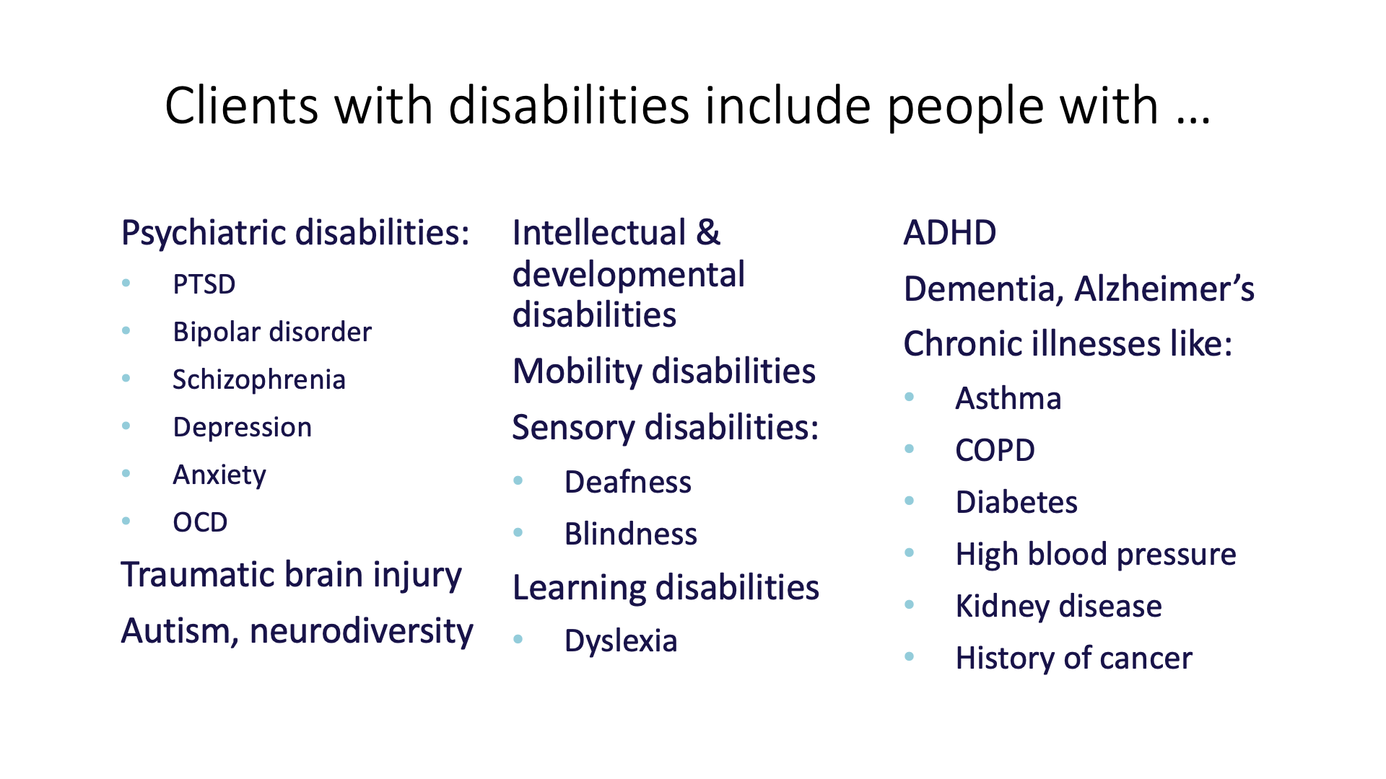
Clients with disabilities

Slide 12
Who is protected by the ADA?
Physical disabilities
Sensory disabilities
Intellectual and developmental disabilities:
  Disability categorized by significant limitations both in intellectual functioning (reasoning, learning, problem solving) and adaptive behavior (range of everyday social and practical skills)
  Originates before age 21
  IQ test: major tool measuring intellectual functioning
  Parents with ID: most parents with an ID label have mild to borderline cognitive impairments (IQ ≤ 80) (IASSID SIRG, 2008)
Psychiatric and mental health disabilities:
  Can include impairments such as depression, anxiety, PTSD, bipolar disorder, or schizophrenia, psychotic disorder
  Impairment substantially limits major life activity such as parenting or social functioning, or impacts major bodily function – regulating mood or decision-making
Substance use: drug/alcohol addiction is a disability under the ADA
  But current and illegal use of drugs limits protection; and completion of or participation in rehabilitation program (if not using) ≠ disabled
  Title II prohibits discrimination against people with substance use disorder based solely on fact that they previously used
  Argument: relapse is part of recovery, so still considered disabled
Notes:
Intellectual functioning: the mental capacity for learning, reasoning, problem solving, etc.
IQ test score below or around 70, or as high as 80, indicates limitation in intellectual functioning
Parents with ID may refer to themselves as slow learners, needed help in school, etc.
Personality d/o may qualify as disabilities if substantial limits a major life activity
“Current use” means illegal use of controlled substances that occurred recently enough to justify a reasonable belief that a person’s drug use is current or that continuing use is a real and ongoing problem
Alcoholism and dependency on prescribed meds is always a disability

Slide 13
Disabled Parents
1 in 10 children in the US have a parent with a disability
Children who live with parents with disabilities can and do thrive
High quality studies show that disability is not predictive for abuse or neglect
¹ National Council on Disability (“NCD”) & Christopher and Dana Reve Foundation, Parenting With a Disability, https://www.ncd.gov/sites/default/files/Documents/Final%20508_Parenting%20Toolkit_Standard_0.pdf (2016)
² National Council on Disability (“NCD”), Rocking the cradle: Ensuring the rights of parents with disabilities, https://heller.brandeis.edu/parents-with-disabilities/pdfs/rocking-the-cradle.pdf (2012)
³ Id. at 186

Slide 14
Disabled Parents
Although children of parents with disabilities comprise less than 10% of the population, they make up 19% of the youth in foster care¹
Removal rates by child welfare system for parents with intellectual, cognitive, developmental, or psychiatric disabilities has been found to be as high as 80% ²
Cases are more likely to be substantiated + less to receive family preservation or reunification services compared to nondisabled parents³
Children of parents with disabilities have longer foster care stays and 32% lower odds at being reunified with parents ⁴
¹ Robyn Powell, Justice for Parents with Disabilities and Their Children, The Regulatory Review, at https://www.theregreview.org/2021/10/26/powell-justice-for-parents-with-disabilities/#:~:text=The%20disproportionate%20rate%20of%20child,the%20children%20in%20foster%20care (Oct 26, 2021)
² Loran B. Kundra and Leslie B. Alexander, Termination of Parental Rights Proceedings: Legal Considerations and Practical Strategies for Parents with Psychiatric Disabilities and the Practitioners Who Serve Them, Psychiatric Rehabilitation Journal 33(2) (2009): 144–145; National Council on Disability (“NCD”), Rocking the cradle: Ensuring the rights of parents with disabilities, https://heller.brandeis.edu/parents-with-disabilities/pdfs/rocking-the-cradle.pdf (2012)
³ Elizabeth Lightfoot & Sharyn DeZelar, The Experiences and Outcomes of Children in Foster Care Who Were Removed Because of Parental Disability, 62 Child. & Youth Srvs. Rev. 22, 26 (2016); Elizabeth Lightfoot et al., Substantiation of Child Maltreatment Among Parents with Disabilities in the United States, 15 J. Pub. Chilld Welfare 584, 592 (2021)
⁴ Lightfoot & DeZelar, supra note 3, at 27

Slide 15
Disability Law & Child Welfare
The ADA and Section 504 of the Rehabilitation Act (for agencies receiving federal funding) apply to the child welfare system
Title II of the ADA applies to public entities, which include state and local governments, and their departments and agencies
This includes the courts!
Notes:
Do not forget about accommodations to access the legal process itself – smaller court rooms, more time for responses, scheduling hearings at alternate times of day etc.

Slide 16
Disability Law & Child Welfare
The ADA and Section 504 of the Rehabilitation Act (for agencies receiving federal funding) apply to the child welfare system
Title II of the ADA applies to public entities, which include state and local governments, and their departments and agencies
This includes the courts!
Notes:
Do not forget about accommodations to access the legal process itself – smaller court rooms, more time for responses, scheduling hearings at alternate times of day etc.

Slide 17
Disability Law and Child Welfare

Slide 18
The ADA Requirements
Child welfare agencies must…
Provide parents with disabilities an equal opportunity to participate in programs, services, and activities, including reasonable modifications, unless such modifications would fundamentally alter the nature of the service, program, or activity. 28 C.F.R. § 35.130(b).
Administer services, programs, and activities in the most integrated setting appropriate to the needs of qualified parents with disabilities. 28 C.F.R § 35.130(d).
Not impose or apply eligibility criteria that screen out or tend to screen out any parents with a disability from fully and equally enjoying any service, program, or activity…28 C.F.R. § 35.130(b)(8).

Slide 19
The ADA Requirements
Child welfare agencies must…
Furnish auxiliary aids and services when necessary to ensure effective communication. 28 C.F.R. § 35.160(a)(1),(b)(1), 28 C.F.R. § 35.164.
Provide, as needed, benefits, services, or advantages beyond those required by the regulation. 28 C.F.R. § 35.130(c).
Not impose surcharges on parents with disabilities to cover the costs of measures to ensure nondiscriminatory treatment. 28 C.F.R. § 35.130(f).
Not deny the benefits of programs, activities, and services to parents with disabilities because entities’ facilities are inaccessible. 28 C.F.R. § 35.149.
Provide services, programs, and activities that, when viewed in their entirety, are readily accessible to and usable by parents with disabilities. 28 C.F.R. § 35.150.
Notes:
Services, programs and activities include parenting supports for parents with MI/ID, that could be peer support, parent aid, parent coach, therapeutic services, accommodations for sensory processing d/o like instructions in writing, recording meetings, bringing scribe,

Slide 20
ADA and Child Welfare Services
Two principles that are fundamental to Title II of the ADA are:
  Individualized treatment
  Full and equal opportunity

Slide 21
Individualized Treatment
Disabled parents must be treated on a case-by-case basis consistent with facts and objective evidence. 28 C.F.R. § 35.130(b); 28 C.F.R. pt. 35, App. B
Disabled parents may not be treated based on generalizations or stereotypes. 28 C.F.R. § 35.130(b); 28 C.F.R. pt. 35, App. B
Examples of prohibitions:
  Removing a child from a parent with a disability based on the stereotypical belief, unsupported by an individual assessment, that disabled parents are unable to safely parent their children
  Denying a person with a disability the opportunity to become a foster or adoptive parent based on stereotypical beliefs about how the disability may affect the individual’s ability to provide appropriate care for a child

Slide 22
Full and Equal Opportunity
Disabled parents must be provided opportunities to benefit from or participate in child welfare programs, services, and activities that are equal to those extended to nondisabled parents. 28 C.F.R. §§ 35.130(b)(1)(ii)-(iv), (vii), (b)(7); 45 C.F.R. § 84.4(b)(1)(ii)-(iii); see also 28 C.F.R. § 42.503(b)(1)(ii), (iii)
Can require the provision of aids, benefits, and services different from those provided to other parents s where necessary to ensure an equal opportunity to obtain the same result or gain the same benefit, such as family reunification. 28 C.F.R. § 35.130(b)(1)(ii)-(iv)

Slide 23
Individualized Treatment and Full and Equal Opportunity
Does not mean lowering standards for disabled parents; rather, services must be adapted to meet the needs of parent to provide meaningful and equal access to the benefit
May mean ensuring physical or programmatic accessibility or providing auxiliary aids and services to ensure adequate communication and participation (e.g., child welfare agency must provide an interpreter for a father who is Deaf when necessary to ensure that he can participate in all aspects of the child welfare interaction)
May mean making reasonable modifications to policies, procedures, or practices (e.g., if a child welfare agency provides classes on feeding and bathing children and a mother with an intellectual disability needs a different method of instruction to learn the techniques, the agency should provide the mother with the method of teaching that she needs)
Source: DOJ/HHS Technical Assistance

Slide 24
Exceptions/Defenses
Fundamental alteration
Undue financial and administrative burdens
Direct threat/legitimate safety requirements

Slide 25
State Trends and Case Examples

Slide 26
DOJ/HHS Enforcement
Jan. 2015
“Sara Gordon” letter of findings
Aug. 2015
DOJ/HHS technical assistance
Dec. 2019
HHS voluntary resolution agreement with Oregon
DOJ/HHS settlement agreement with Massachusetts
Apr. 2021
DOJ settlement with Washington
Nov. 2020
Aug. 2023
HHS voluntary resolution agreement with Pennsylvania
March 2022
DOJ/HHS voluntary resolution agreement with Rhode Island

Slide 27
DOJ/HHS letter of findings (“Sara Gordon” case)
January 29, 2015, Letter of Findings to DCF
Mother with I/DD, lost custody of newborn
State violated ADA and Section 504
State must provide mother appropriate supports and opportunity to demonstrate fitness
Available at http://www.ada.gov/ma_docf_lof.pdf
Family was reunited after 2 years, 3 months, and 12 days!

Slide 28
DOJ/HHS Technical Assistance
August 10, 2015
Overview of the issues and application of ADA and Section 504
Answers to specific questions and implementation examples for child welfare agencies and courts
Resources to consult for additional information
Available at http://www.ada.gov/doj_hhs_ta/child_welfare_ta.pdf

Slide 29
In re Hicks/Brown, 893 N.W.2d 637 (Mich. 2017)
Mother with intellectual disability, never provided reasonable accommodations
Reversed TPR: agency and the court have responsibility to ensure a parent's disabilities are reasonably accommodated if they know of or should know of the disabilities
  Places the responsibility on the courts and agency to ensure that the parent's disability is properly evaluated and accommodated
  Before, the parent had to raise the ADA or its protections were deemed waived
Notes:
Hicks/Brown: Cited DOJ/HHS Guidance, Rocking the Cradle
While the court of appeals reasonably identified measures the Department should consider when determining how to reasonably accommodate a disabled individual, the Supreme Court did not believe these steps will necessarily be implicated in every disability case.

Slide 30
People ex rel. C.Z., 2015 COA 87, 360 P.3d 228
Mother with psychiatric disability:
  “unwilling” to comply with mental health treatment
  father also has psychiatric disability
  Parents had TPR with older children
Trial court found no appropriate treatment plan could be devised to address parents’ “unfitness” due to their disabilities
Parents appealed TPR
Though unsuccessful, the appeals court finds that although ADA does not limit the court's authority to terminate a disabled parent's rights when the parent is unable to meet his or her child's needs, the ADA applies to the provision of assessments, treatment, and other services that a department provides to parents through a dependency and neglect proceeding prior to the TPR hearing
Notes:
C.Z.: HOLDINGS: [1]-Termination of parental rights was proper because the Americans with Disabilities Act did not pre-empt Colo. Rev. Stat. § 19-3-604(1)(b)(I) (2014), which authorized termination based on a finding that no appropriate treatment plan could be devised to address a parent's unfitness caused by mental impairment, and termination was in the child's best interest since the child needed permanency and the termination report established that no remedy other than termination would provide the child with the permanency that he needed.

Slide 31
People ex. Rel. S.K., 2019 COA 36, 440 P.3d 1240
Mother with intellectual and psychiatric disabilities, infant child
  Juvenile Court concluded parent’s disabilities severely limited their ability to care for the child
  Parents appealed – contended Department did not make reasonable efforts to reunify them with the child, or to rehabilitate them in light of the ADA and section 504
  Appeal unsuccessful, but Court said must consider if reasonable efforts were made to rehabilitate the parents – standard is met when services are provided (assessments, case plans, referrals to assistance resources, etc.); the Department and Juvenile Court must account for and make reasonable accommodations for the parent’s disability when making a treatment plan

Slide 32

California and the ADA
The only reported state appellate court cases, both in the 4th district and in 2000, ruled that the ADA cannot be used as a defense to termination of reunification services or parental rights
  In re Diamond H., 82 Cal. App. 4th 1127 (2000)
    Developmentally disabled mother appealed an order denying reunification services under bypass provision saying doing so violated her rights under the ADA
    Court held that the ADA does not allow for a parent to attack state court order during dependency proceeding
    “Congress did not intent to change the obligations imposed by unrelated statutes”
  In re Anthony P., 84 Cal. App. 4th 1112 (2000)
    Parent with schizoaffective disorder could not use ADA to preempt sister’s attempts to terminate parental rights and adopt child
    “Dependency proceedings are held for the benefit of the child and not parent”
    “These types of proceedings are not services, programs, or activities within the meaning of the Title II of the ADA”

Slide 33
However, California cases have interpreted their dependency codes in ways aligned with the ADA since
Not sufficient to merely show parent suffers from mental health disability, CPS must show how child has been harmed as a result of disability
    In re James R., 176 Cal. App. 4th 129, 136 (2009), abrogated by In re R.T., 3 Cal. 5th 622 (2017); In re A.G., 220 Cal. App. 4th 675, 683 (2013), as modified (Oct. 22, 2013);
    In re David M., 134 Cal. App. 4th 822, 830 (2005), abrogated by In re R.T., 3 Cal. 5th 622 (2017)
Harm to child cannot be presumed from mere fact that parent has mental illness
  Kimberly R. v. Superior Ct., 96 Cal. App. 4th 1067, 1079 (2002); In re A.L., 18 Cal. App. 5th 1044, 1050 (2017)

Slide 34
However, California cases have interpreted their dependency codes in ways aligned with the ADA since
Disability should be “starting point” for family reunification and failure to tailor and “accommodate the special needs of disabled… parents” can violate CA’s “reasonable efforts” requirement
    Tracy J. v. Superior Ct., 202 Cal. App. 4th 1415, 1425-26 (2012), citing to In re Elizabeth R., 35 Cal. App. 4th 1774, 1792-1794 (1995); In re K.C., 212 Cal. App. 4th 323 (2012); T.J. v. Superior Ct., 21 Cal. App. 5th 1229, 1244 (2018); Patricia W. v. Superior Ct., 244 Cal. App. 4th 397 (2016)

Slide 35
Case Example
Mother with schizophrenia has a psychotic episode while she and child are unstably housed. Child is a “Regional Center client,” has a developmental cognitive disability
During the episode mother had suicidal ideation and child contacted police for help
  Episode was a result of not having access to medication, consistent support, and unstable housing
Assumptions about schizophrenia came into play with deciding to remove the child and continue having child in out of home placement

Slide 36
Case Example (cont.)
While the allegation was concerning on paper, other factors indicated mom was safe parent for child
  Mom ensured child was in specialized school for disability
  Child and mom both mentioned having a very positive supportive relationship
  One of the only episodes child witnessed in 15 years of being with mom
  Reason for housing stability was because mom moved child out of home after child reported sexual assault with someone in home
  When group home had issues with child, only the mom knew how to meet child’s physical needs and coach people in child’s care

Slide 37
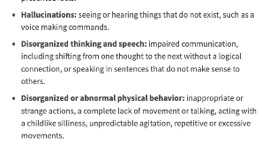

Myths about Schizophrenia
People with schizophrenia are not violent, more likely to self harm (40-50%)
People with schizophrenia are more likely to be victims of violence
Noticing signs of psychosis can help get help quicker and curb risk

Slide 38
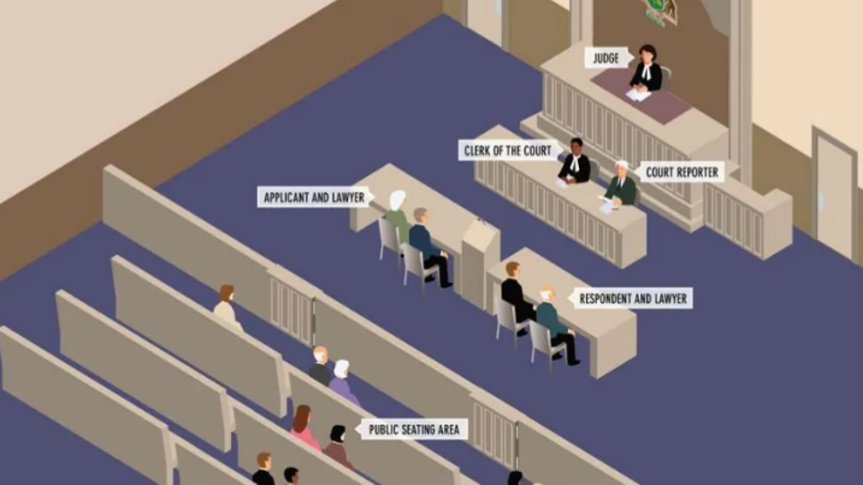
Case example: visual aids
Mother with ID was being considered for guardian ad litem because she was not following communication with lawyer. Instead, communicating with plain language and visual aids supported her in avoiding GAL

Slide 39
Q&A

Slide 40
Keeping Families Together
Training #2
Legal Strategies for Defending the Rights of Disabled Parents
Wednesday, May 14, 2025
2:00 p.m. EST
1:00 p.m. CST
12:00 p.m. MST
11:00 a.m. PST
YOU WILL RECEIVE SECOND SURVEY AFTER TRAINING #2

Slide 41


Resources
National Research Center for Parents with Disabilities http://heller.brandeis.edu/parents-with-disabilities/index.html
Disabled Parenting Project https://www.disabledparenting.com/
Rocking the Cradle: Ensuring the Rights of Parents with Disabilities and their Families https://ncd.gov/publications/2012/Sep272012
Child Welfare Information Gateway https://www.childwelfare.gov/
The Association of Successful Parenting http://achancetoparent.net/
Bazelon Center for Mental Health Law http://www.bazelon.org/our-work/mental-health-systems/parental-rights/

Slide 42





Learn more/contact us
@NatRCPD @LurieInstitute
facebook.com/LurieInstitute
lurie.brandeis.edu

Slide 43
National Research Center for Parents with Disabilities
The National Research Center for Parents with Disabilities is a cross-disability organization that supports parents with disabilities through services, research, information, and advocacy. It is guided by the ethos of the disability community, “nothing about us without us. It is part of the Lurie Institute for Disability Policy at Brandeis University.
The Disability Rights Education and Defense Fund (DREDF) is a leading national civil rights law and policy center directed by individuals with disabilities and parents who have children with disabilities. Its mission is to to advance the civil and human rights of people with disabilities through legal advocacy, training, education, and public policy and legislative development.

Slide 44

Funding
  The contents of this presentation were developed under a grant from the National Institute on Disability, Independent Living, and Rehabilitation Research (NIDILRR grant number 90DPCP0012). NIDILRR is a Center within the Administration for Community Living (ACL), Department of Health and Human Services (HHS). The content is solely the responsibility of the authors and does not necessarily represent the official views of NIDILRR, ACL, or HHS.
Notes:
Th

