Slide 1
MA Health Policy Student Forum
CHIA’s Mission in Context
Andrew Jackmauh ■ January 7, 2026

Slide 2
About CHIA

Slide 3
Core Responsibilities
Collect
Analyze
Report

Slide 4
Core Responsibilities
The ability to compel data sets CHIA apart
Collect
Analyze
Report

Slide 5



Actionable, Accessible, and Adaptable
CHIA’s Strategic Goals
Usable and accessible data
Actionable communication
Adaptable to changes in health care environment

Slide 6
Leadership Structure
EXECUTIVE DIRECTOR appointed by Governor, AGO, Auditor Lauren Peters
OVERSIGHT COUNCIL
PEOPLE OPERATIONS Tonya Bourassa, Chief People Officer
LEGAL Robert MacLean, General Counsel
EXECUTIVE OPERATIONS Andrew Jackmauh, Chief of Staff
HEALTH INFORMATICS AND REPORTING Caitlin Sullivan, Deputy Executive Director Health System Informatics Health Care Quality Primary Care/ Behavioral Health Prescription Drugs Relative Price Enrollment Trends
PROVIDER FINANCE Steve McCabe, Deputy Executive Director Provider Analytics Pricing Analytics Health Services Pricing Provider System Financials MassHealth Pricing/ Provider Cost Reports
STRATEGY AND RESEARCH Zi Zhang, Deputy Executive Director External Research and Surveys Equity Research Briefs Workforce Household and Employer Coverage Readmission Rates
DATA OPERATIONS AND TECHNOLOGY Michael Cocchi, Chief Data Officer Data Security Data Transformation and Release Application Development Partner Operations and Data Compliance IT Administration, Operations, and Project Management
COMMUNICATIONS Lani Harac, Director of Communications and Content Strategy
FINANCE Nicholas Dantzer, CFO

Slide 7

Oversight Council
MEMBERS
3 gubernatorial appointments
Fay Donohue (Vice Chair) Health care delivery or management
Adrianna McIntyre Big data, open data, and analytics
Jean Yang Finance and budgeting
2 attorney general appointments
Amie Shei Health equity advocate
Lou Chitkushev Cybersecurity
2 state auditor appointments
Brent Benson
Alan Sager Health care economist
4 ex-officio seats
Secretary of HHS (Current Chair)
Secretary of ANF
Commissioner of Insurance
Executive Director of HPC
AREAS OF AUTHORITY
MEETING CYCLE
MISCELLANY
Budget
Prepare annual operating budget
Hold annual hearing
Research and analytic priorities
Data guidelines
Collection, storage, and maintenance of CHIA data
January
March
June
September
+ Budget hearing (spring)
5-year term for appointments
Eligible for reappointment
Members prohibited from employment or affiliation with ASC, hospital, or insurer
Council members considered special state employees

Slide 8

CHIA’s Role
in the Massachusetts Health Care Ecosystem

Slide 9

Interest Across the System
CHIA’s Primary Stakeholders
Legislature
Market Participants/ Data Providers
Payers (insurers, health plans)
Providers (hospitals, health systems, physicians, nursing facilities, CHCs)
Sister Agencies
Health Policy Commission
Executive Office of Health and Human Services
MassHealth (Medicaid)
Department of Public Health
Health Connector
Other Data Users
Policymakers
Trade groups
Employers
News media organizations
Researchers
Advocacy groups
CHIA Appointing Authorities
Governor
Attorney General
State Auditor
Commonwealth Residents

Slide 10
Maintain the State’s Largest Health Care Data Assets
Core Responsibility: Data Collection and Management
All-Payer Claims Database (MA APCD)
utilization and payment data submitted by payers
Authorized to compel data from payers and providers
Process data file submissions
~9,000 data submissions
~2,000 submitters
Fulfill data requests
~250 requests in 2024
Statewide Surveys
health insurance, health care workforce, employers
Hospital Case Mix Databases
inpatient discharges, ED visits, observation stays
Payer Aggregate Data
summary-level spending data from payers
Provider Financials/ Cost Reports
detailed financial statements and cost reports from hospitals, nursing facilities, etc.
Electronic Health Record Data
patient demographics (RELD/SOGI)

Slide 11
Massachusetts All-Payer Claims Database (MA APCD)
Claims, Eligibility, Provider, and Product-Level Data
10+ years monthly data from ~60 commercial and public health care payers
Paid medical, pharmacy, dental claim lines including services rendered, amounts paid by payer and patient
Subscriber and member information including demographics, coverage/plan data, PCP, premiums
Enhanced APCD (“eAPCD”)
Standardized analytic functionality improves consistency of results and reduces steps
User-friendly interface removes IT burden for sister agencies to handle extracts

Slide 12

Hospital Case Mix Databases
Discharge-Level Data on Inpatient Admissions, ED Visits, and Observation Stays
20+ years quarterly data from ~70 acute care and private behavioral health hospitals
Administrative, not clinical
Patient demographics
Admission/discharge information
Diagnostic/procedural coding
Provider details
Charges
Monitor utilization patterns, support public health initiatives, analyze preventable hospitalizations/ readmissions, comparative cost/outcomes research

Slide 13
Statewide Surveys
Perspectives From Residents, Employers, and Health Care Workforce
 | MA Health Insurance Survey (MHIS) | MA Employer Survey (MES) | MA Health Care Workforce Survey (MHCW)
fielded: first data year: | odd years 2009 | even years 2010 | odd years 2023
monitors: | residents’ health care coverage, access, utilization, affordability | employer insurance market, cost-sharing, benefit decision-making | health care/human services provider organization staffing capacity, diversity
survey size: | ~5,000 state residents (random sample) | ~1,000 private MA firms (random sample) | ~700 provider organizations from 11 sectors
Inform policies and programs and support ongoing tracking of key issues in Commonwealth Primary sources for CHIA’s analysis and reporting on health equity

Slide 14

Provider Financials/Cost Reports
Financial metrics and Margins From Health Care Providers
Quarterly and annual financial statements from acute hospitals, affiliated physician groups, hospital health systems
Annual financial reports from hospitals, nursing homes, other health care providers*
Support information transparency, financial monitoring, cost and utilization analyses, and MassHealth rate-setting activities
*Adult Day Health, Adult Foster Care, Ambulance and Chair Car, Community Health Centers, Group Adult Foster Care, Nursing Services (Home Health, Continuous Skilled Nursing Services, Temporary Nursing Services), and Resident Care (Rest Homes)

Slide 15

Payer Aggregate Data
Commercial Health Plan Reporting on Expenditure and Utilization Metrics
10+ years annual data from 18 commercial payers representing most Massachusetts residents with private, Medicaid, or Medicare insurance coverage
Reports on insurance coverage, premiums, cost-sharing, benefit design, relative prices
Calculation of key metrics
Total health care expenditures (THCE)
Premium and member cost-sharing trends
Primary care/behavioral health spending
Statewide relative price (S-RP)

Slide 16
Provide Actionable Intel With In-Depth Analysis
KEY EXAMPLES
Health Care System Performance
Workforce Capacity
Primary Care and Behavioral Health
Inpatient Capacity
Hospital Financials
Core Responsibility: Data Analysis
Overall health system performance
Health insurance enrollment and coverage
Availability of and access to health care services
Utilization of health care services
Affordability (cost of services to residents)
Finance (spending on services by payers/providers)
Quality (standards/value of services)
Health equity
Ad hoc regulatory, policy, other government response needs

Slide 17
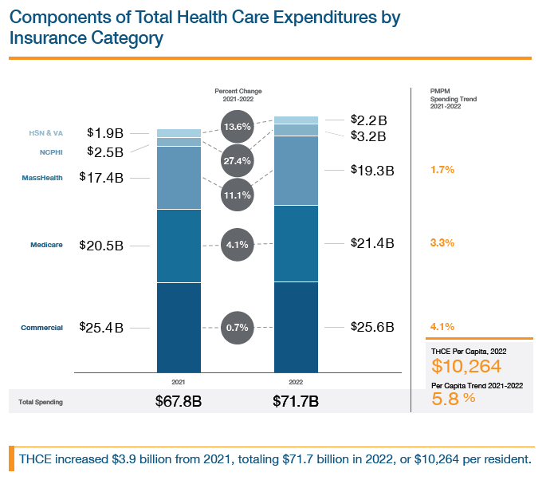
Health Care System Performance
CHALLENGE
Efforts to contain rising health care costs for residents required ability to measure and track health care cost trends
DATA USE CASE
Multiple datasets analyzed for CHIA’s “Annual Report on the Performance of the Massachusetts Health Care System,” notably payer aggregate data
DATA-SUPPORTED OUTCOMES
Annual calculation of Total Health Care Expenditures (THCE) to measure performance against Cost Growth Benchmark
Total Medical Expenses (TME) for payer and provider referrals to HPC

Slide 18
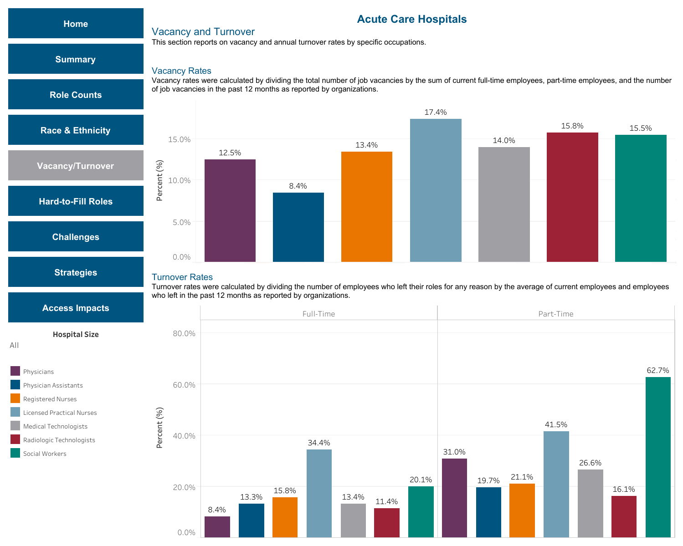
Workforce Capacity
CHALLENGE
Significant workforce shortages across health care system; no standardized data or objective quantification of problem
DATA USE CASE
Health Care Workforce Survey collects statewide quantitative (e.g., vacancy and turnover rates) and qualitative (e.g., recruitment and retention challenges) data across 10-plus sectors
DATA-SUPPORTED OUTCOMES
Provides objective fact base for ongoing monitoring of key sectors and metrics
Informs effectiveness of workforce investments, policies, and initiatives

Slide 19
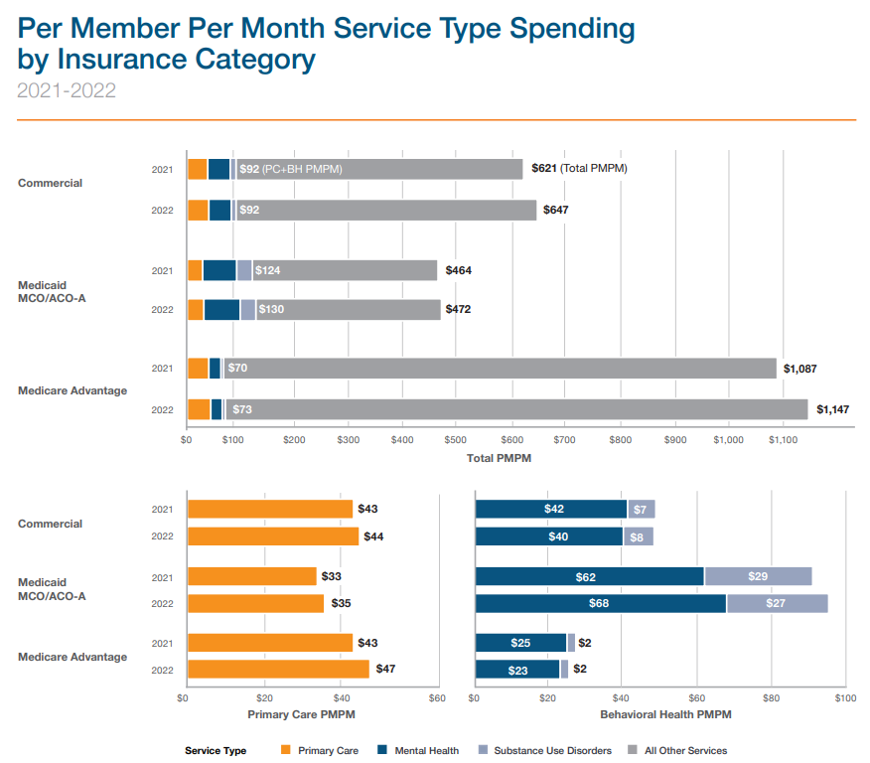
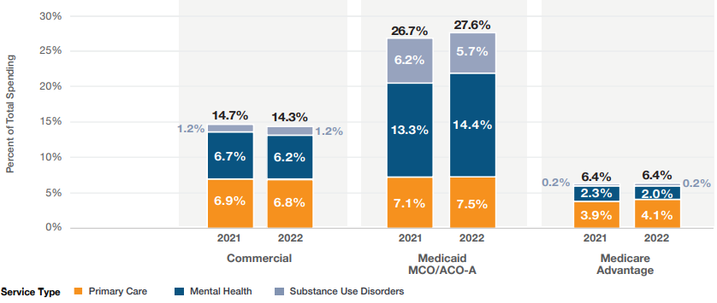
Primary Care and Behavioral Health
CHALLENGE
Absence of information about current spending on primary care and behavioral health care undermined efforts to advance policies and investments and support reforms in these areas
DATA USE CASE
Payer aggregate data (payer-paid, cost-sharing, etc.) to quantify spending on these services at system and payer/provider level
DATA-SUPPORTED OUTCOMES
Establishment of spending baselines to help advance related policies and investments
Increases transparency and accountability with entity-level data

Slide 20
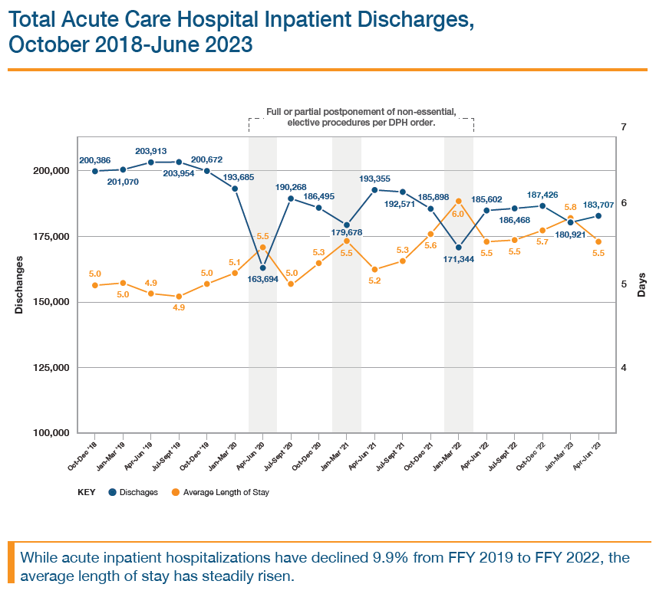
Inpatient Capacity
CHALLENGE
Hospitals strained, operating at max capacity during COVID-19 pandemic and years following
DATA USE CASE
Hospital Inpatient Discharge Data (HIDD) (discharge volume, length of stay, post-acute discharge setting, etc.) to determine contributing factors
DATA-SUPPORTED OUTCOMES
Determined one main driver was a bottleneck, not a net increase in patients
Informed targeted interventions

Slide 21
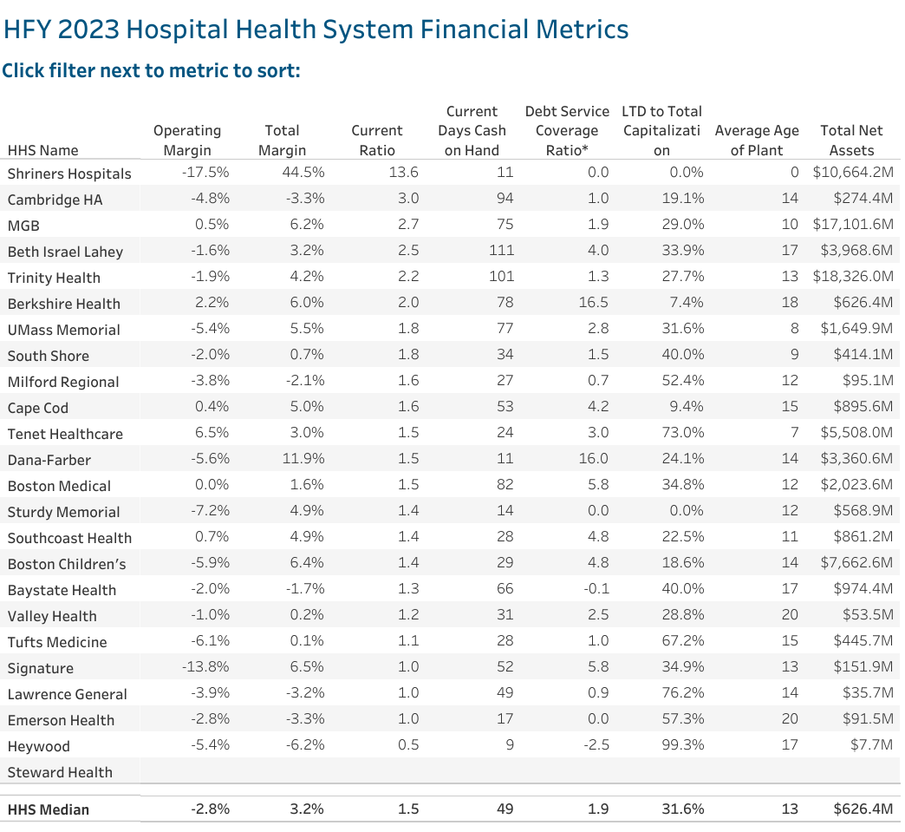
Hospital Financials
CHALLENGE
Lack of visibility into financial performance of current providers and new market entrants (e.g., private equity, for-profit management)
DATA USE CASE
Provider Financials used to measure and track key indicators of fiscal “health” (e.g., liquidity, solvency, and profitability)
DATA-SUPPORTED OUTCOMES
Enables early identification of and intervention in potential problems, used extensively by HPC, AGO, DPH in oversight capacity
Increases transparency of market transactions

Slide 22
Share Key Findings Through Extensive Reporting
Core Responsibility: Disseminate Health Care Information
40-plus reports and publications released each year address key questions
Do wage increases improve health care workforce recruitment/retention?
Will enough MDs/DOs enter primary care to replace those leaving?
How do sociodemographic characteristics impact access and affordability?
What proportion of residents had unmet behavioral health needs due to cost?
Is prescription drug spending up because more prescriptions are being filled?
Can acute hospitals in MA pay current debts with existing assets?
Does having health insurance prevent affordability issues for residents?
Is the average monthly health insurance premium higher in MA or the US?

Slide 23





Connect With CHIA
Subscribe
Follow
Visit

Slide 25
Thank You
Andrew Jackmauh, Chief of Staff Center for Health Information and Analysis andrew.jackmauh@chiamass.gov

