Slide 1
Accessibility and Health Starts Before Pregnancy: Tailored Preconception Education with People with Mobility Disabilities
Panelists: John Harris, MD
Kieran O’Brien Kern
Moderator: Nicole Lomerson, MPH
April 2, 2025

Slide 2
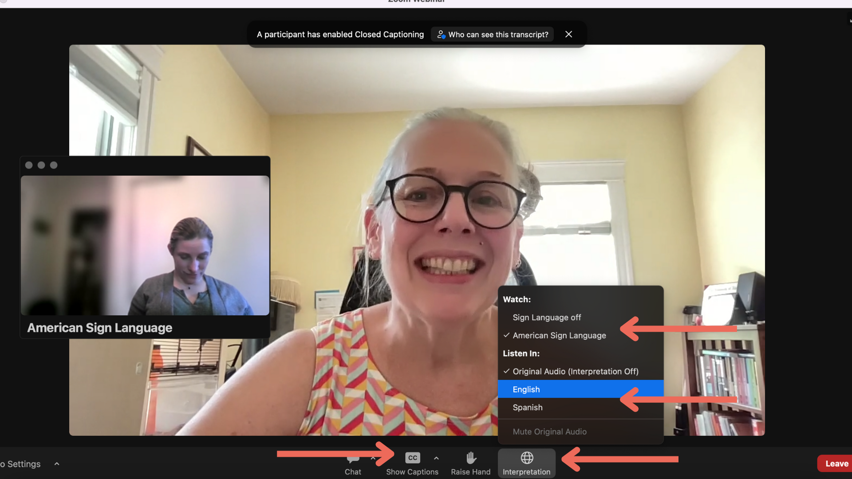
Interpretation and captioning

Slide 3
Funding
The contents of this presentation were developed under a grant from the National Institute on Disability, Independent Living, and Rehabilitation Research (NIDILRR grant number 90DPHF0011). NIDILRR is a Center within the Administration for Community Living (ACL), Department of Health and Human Services (HHS). The content is solely the responsibility of the authors and does not necessarily represent the official views of NIDILRR, ACL, or HHS.
Notes:
Th

Slide 4
Conflicts of interest (John Harris)
Agency for Healthcare Research and Quality
National Institute on Disability, Independent Living, and Rehabilitation Research
National Institute of Child Health and Human Development
Pennsylvania Department of Health
Craig H. Neilsen Foundation
Novo Nordisk, paid participant in a virtual advisory board on women's health and obesity management
Conflicts of interest (Kieran O’Brien Kern)
None

Slide 5
Kieran’s Preconception, Pregnancy, and Parenting Story

Slide 6
Switch Zoom from sharing slide show to show Kieran’s video

Slide 7
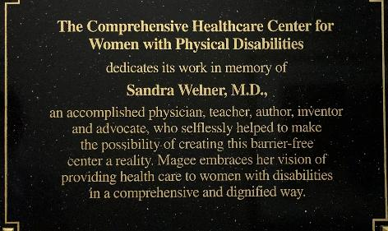
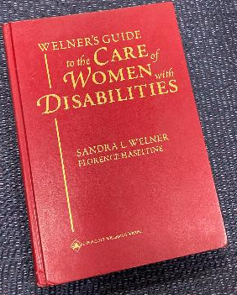
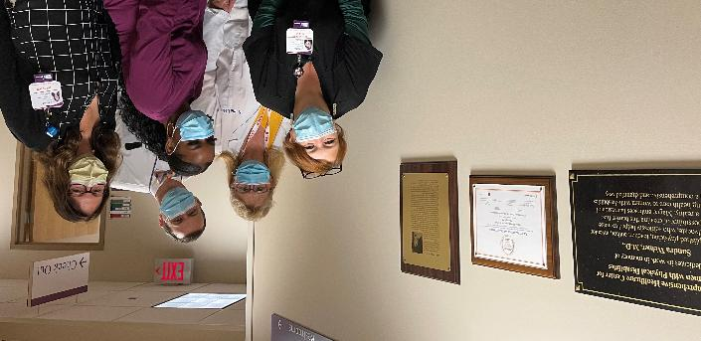
Acknowledgements and Colleagues
Sandra Welner MD (1959-2001)
Stephen Corey MD (retired)
Peter Bulova MD
Julie McKechnie CNM
Jennifer Stephens RN

Slide 8
Acknowledgements and Colleagues

Slide 9
What are the problems for people with mobility disability before and during pregnancy outcomes? How can preconception education improve health and pregnancy outcomes?

Slide 10
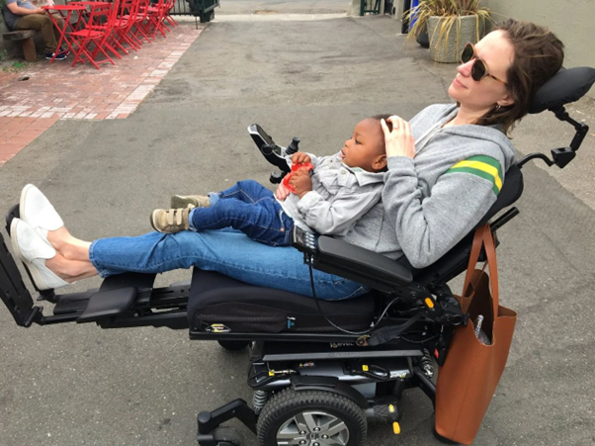
How significant are the health and system issues related to pregnancy and disability?
“I don’t see that many patients or have many friends with a disability”
12% of US reproductive-aged women have a disability
2-3% have intellectual disability
0.6% deaf, 6.3% difficulty hearing
2.0% with visual disability
1.6% use a wheelchair
Jessica Slice, Nov 18, 2019. My Power Wheelchair Makes Me a Better Mom. Photograph. https://www.nytimes.com/2020/04/17/parenting/wheelchair-dysautonomia-ehlers-danlos-syndrome.html
Centers for Disease Control and Prevention. Prevalence and most common causes of disability among adults: United States, 2005. MMWR 2009;58:421–426
https://nationaldeafcenter.org/resources/research-data/
https://nfb.org/resources/blindness-statistics
Mobility Device Use in the United States (disabled-world.com). 2000.

Slide 11
How significant are the health and system issues related to pregnancy and disability?
In 2010 BRFSS data, preconception risk factors are higher for women (18-44 yo) with disabilities
Smoking: 31% vs 15%
Regular Exercise: 67% vs 80%
Fair/Poor Reported Health: 35% vs 12%
Diabetes: 12% vs 6%
Frequent Mental Distress: 35% vs 9%
Obesity: 38% vs 23%
Asthma: 29% vs 13.5%
Adequate Social Support: 68% vs 84%
Mitra M, Clements KM, Zhang J, Smith LD. Disparities in Adverse Preconception Risk Factors Between Women with and Without Disabilities. Matern Child Health J. 2016 Mar;20(3):507-15.

Slide 12
How significant are the health and system issues related to pregnancy and disability?
Women with disabilities are not very pleased with their providers
In a survey of 126 women with disabilities who were pregnant
Somewhat or very hard to find a prenatal provider: 22%
The prenatal provider had a negative reaction to pregnancy: 35%
“You might not be able to take care of your baby”: 32%
“Your physical disability might be passed on to your child” : 30%
“Pregnancy or childbirth might be harmful to you”: 14%
Perceived provider knowledge of disability’s effects on pregnancy:
Little or nothing at all 40%
Satisfaction with prenatal care provider (0-10)
8-10; 69%
0-7; 31%
Mitra M, Akobirshoev I, Moring NS, Long-Bellil L, Smeltzer SC, Smith LD, Iezzoni LI. Access to and Satisfaction with Prenatal Care Among Pregnant Women with Physical Disabilities: Findings from a National Survey. J Womens Health (Larchmt). 2017 Dec;26(12):1356-1363.

Slide 13
How significant are the health and system issues related to pregnancy and disability?
If preconception health and provider experience are not great, it is not surprising that pregnancy outcomes are poor
In Rhode Island Pregnancy Risk Assessment and Monitoring System (2002-2011)
Nausea: 42% vs 27%
Kidney and Bladder Infections: 21% vs 13%
Preterm Labor: 33% vs 27%
Preterm Rupture of Membranes: 7% vs 5%
Emotional Stress: 43% vs 31%
Partner-related Stress: 52% vs 29%
Financial Stress: 67% vs 49%
Mitra M, Clements KM, Zhang J, Iezzoni LI, Smeltzer SC, Long-Bellil LM. Maternal Characteristics, Pregnancy Complications, and Adverse Birth Outcomes Among Women With Disabilities. Med Care. 2015 Dec;53(12):1027-32.

Slide 14
How significant are the health and system issues related to pregnancy and disability?
Birth and Postpartum outcomes are worse
Low Birth Weight: 10% vs 7%
Preterm Birth: 13% vs 9%
Cesarean Delivery: no difference*
>14 days in the hospital: 9% vs 6%
NICU admission: 14% vs 10%
Ever breastfed: 70% vs 75%
Postpartum check up visit: 87% vs 94%
Infant mortality: 1.2% vs 0.4%
Mitra M, Clements KM, Zhang J, Iezzoni LI, Smeltzer SC, Long-Bellil LM. Maternal Characteristics, Pregnancy Complications, and Adverse Birth Outcomes Among Women With Disabilities. Med Care. 2015 Dec;53(12):1027-32.
In other studies, C/S is higher in disabilities populations (SCI, MS, ID/DD). Signore C, Davis M, Tingen CM, Cernich AN. The Intersection of Disability and Pregnancy: Risks for Maternal Morbidity and Mortality. J Womens Health (Larchmt). 2021 Feb;30(2):147-153

Slide 15
General Preconception or Prepregnancy Visit
The best way to have a healthy pregnancy, birth, and postpartum period is to be as healthy as possible BEFORE becoming pregnant
Typically focused on people who are interested in becoming pregnant in the next year
Basic goals of preconception visit:
Screen for potential risks to the person planning to become pregnant and fetus
Education about potential risks, options for intervention and management to reduce risk
Initiate interventions to provide optimum maternal and fetal health before pregnancy begins
Centers for Disease Control and Prevention. About Planning for Pregnancy. https://www.cdc.gov/pregnancy/about/index.html. Accessed 3/25/25.
March of Dimes. Your checkup before pregnancy. https://www.marchofdimes.org/find-support/topics/planning-baby/your-checkup-pregnancy. Accessed 3/25/25.
ACOG. American College of Obstetricians and Gynecologists, Committee on Gynecologic Practice. Prepregnancy counseling: committee opinion No. 762. Fertility and sterility. 2019 Jan 1;111(1):32-42.
UpToDate. Sackey JA, Blazey-Martin, D. The prepregnancy office visit. Last updated 9/25/24.

Slide 16
Designing and Testing a Tailored Preconception Health Educational Intervention for Women with Mobility Disability

Slide 17
Preconception Education Curriculum Development
A subproject of a larger grant from the National Institute on Disability, Independent Living, and Rehabilitation Research
Focused on mobility disability
Spinal Cord Injury
Spina Bifida
Multiple Sclerosis
Cerebral Palsy
Stroke
Rheumatoid Arthritis
Traumatic Brain Injury
Ehlers-Danlos Syndrome
Gabor A, Stephens J, McKee MM, Brown HK Ayers KB, Valentine A, Horner-Johnson W, Mitra M, Harris JA. Consensus Preconception Educational Domains for People with Mobility Disability: a Delphi study. Women’s Health Issues. 2024 Dec 21:S1049-3867(24)00119-1.
McCabe MA, Gabor A, Stephens J, McKee MM, Brown HK Ayers KB, Valentine A, Horner-Johnson W, Mitra M, Harris JA. Pilot Study for a Preconception Educational Intervention for People with Mobility Disabilities. Under review.

Slide 18
Preconception Education Curriculum Development
Our study had three phases
A systematic review of previously reported domains on preconception counseling
A modified Delphi study,--a panel of subject-matter 18 experts to define consensus domains important for mobility disability
A pilot educational intervention study using the consensus domains
Gabor A, Stephens J, McKee MM, Brown HK Ayers KB, Valentine A, Horner-Johnson W, Mitra M, Harris JA. Consensus Preconception Educational Domains for People with Mobility Disability: a Delphi study. Women’s Health Issues. 2024 Dec 21:S1049-3867(24)00119-1.
McCabe MA, Gabor A, Stephens J, McKee MM, Brown HK Ayers KB, Valentine A, Horner-Johnson W, Mitra M, Harris JA. Pilot Study for a Preconception Educational Intervention for People with Mobility Disabilities. Under review.

Slide 19
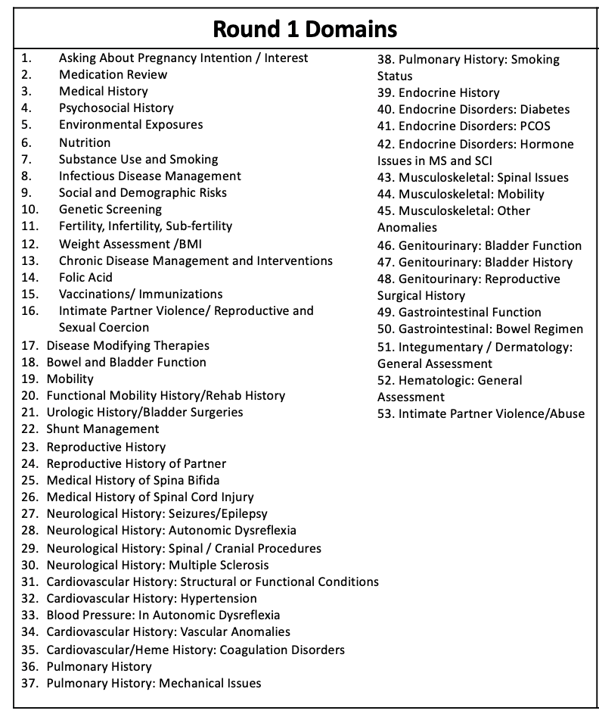
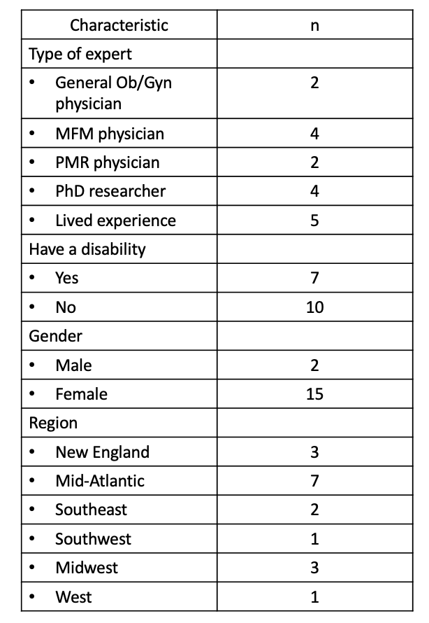
Round 1 domains

Slide 20
Tailored Preconception Educational Topics
Pregnancy Intention
Infertility and Obstetric History
Genetic History and Screening
Medical History
Medication History
Mental Health
Nutrition and Weight History
Social Determinants of Health
Intimate Partner Violence and Caregiver Abuse
Functional Mobility and Physical Accommodation
Musculoskeletal and Skin Health
Bowel and Bladder Surgery and Health
Neurological and Neurosurgical Health

Slide 21
Testing a tailored preconception education
26 participants piloted a nurse educator phone-based preconception health curriculum
Each call covered all 13 educational domains
Conversational educational method “Representation Method” discusses the participants’ current knowledge, current gaps in knowledge, interest in learning new knowledge, new knowledge, and future resources
Calls lasted about 1 hour
Gabor A, Stephens J, McKee MM, Brown HK Ayers KB, Valentine A, Horner-Johnson W, Mitra M, Harris JA. Consensus Preconception Educational Domains for People with Mobility Disability: a Delphi study. Women’s Health Issues. 2024 Dec 21:S1049-3867(24)00119-1.
McCabe MA, Gabor A, Stephens J, McKee MM, Brown HK Ayers KB, Valentine A, Horner-Johnson W, Mitra M, Harris JA. Pilot Study for a Preconception Educational Intervention for People with Mobility Disabilities. Under review.

Slide 22
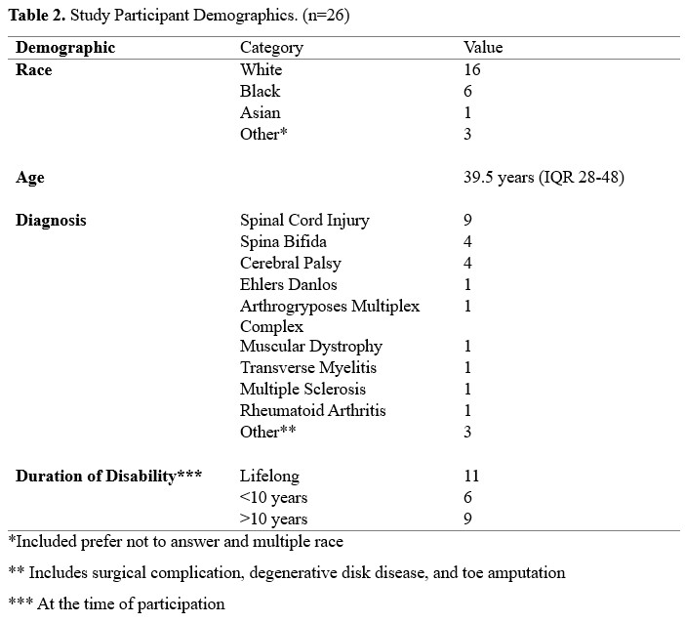
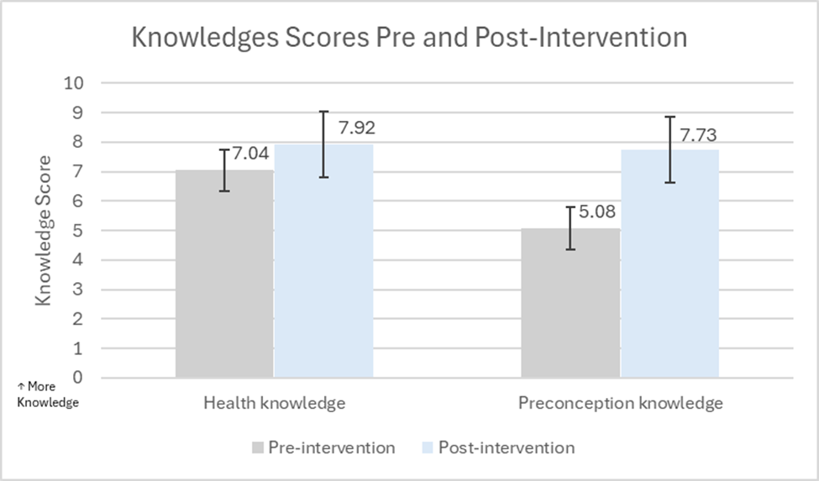
Testing a tailored preconception education
Gabor A, Stephens J, McKee MM, Brown HK Ayers KB, Valentine A, Horner-Johnson W, Mitra M, Harris JA. Consensus Preconception Educational Domains for People with Mobility Disability: a Delphi study. Women’s Health Issues. 2024 Dec 21:S1049-3867(24)00119-1.
McCabe MA, Gabor A, Stephens J, McKee MM, Brown HK Ayers KB, Valentine A, Horner-Johnson W, Mitra M, Harris JA. Pilot Study for a Preconception Educational Intervention for People with Mobility Disabilities. Under review.

Slide 23
Testing a tailored preconception education
The next step is a larger trial to learn if disability-tailored preconception education improves detailed preconception health knowledge, self-control of preconception health compared to usual preconception education
We will interview participants who get pregnant in future years
Gabor A, Stephens J, McKee MM, Brown HK Ayers KB, Valentine A, Horner-Johnson W, Mitra M, Harris JA. Consensus Preconception Educational Domains for People with Mobility Disability: a Delphi study. Women’s Health Issues. 2024 Dec 21:S1049-3867(24)00119-1.
McCabe MA, Gabor A, Stephens J, McKee MM, Brown HK Ayers KB, Valentine A, Horner-Johnson W, Mitra M, Harris JA. Pilot Study for a Preconception Educational Intervention for People with Mobility Disabilities. Under review.

Slide 24
General Preconception or Prepregnancy Visit
Learning about the person
Medical problems and history
Surgical history
Medications
Reproductive history
Genetic and family history
Substance use
Infectious Diseases and Vaccinations
Nutrition and Exercise
Mental Health
Social Determinants of Health
Centers for Disease Control and Prevention. About Planning for Pregnancy. https://www.cdc.gov/pregnancy/about/index.html. Accessed 3/25/25.
March of Dimes. Your checkup before pregnancy. https://www.marchofdimes.org/find-support/topics/planning-baby/your-checkup-pregnancy. Accessed 3/25/25.
ACOG. American College of Obstetricians and Gynecologists, Committee on Gynecologic Practice. Prepregnancy counseling: committee opinion No. 762. Fertility and sterility. 2019 Jan 1;111(1):32-42.
UpToDate. Sackey JA, Blazey-Martin, D. The prepregnancy office visit. Last updated 9/25/24.

Slide 25
General Preconception or Prepregnancy Visit
Physical exam with provider
General physical exam
Measure blood pressure and height and weight
Testing for infections, diabetes
Centers for Disease Control and Prevention. About Planning for Pregnancy. https://www.cdc.gov/pregnancy/about/index.html. Accessed 3/25/25.
March of Dimes. Your checkup before pregnancy. https://www.marchofdimes.org/find-support/topics/planning-baby/your-checkup-pregnancy. Accessed 3/25/25.
ACOG. American College of Obstetricians and Gynecologists, Committee on Gynecologic Practice. Prepregnancy counseling: committee opinion No. 762. Fertility and sterility. 2019 Jan 1;111(1):32-42.
UpToDate. Sackey JA, Blazey-Martin, D. The prepregnancy office visit. Last updated 9/25/24.

Slide 26
General Preconception or Prepregnancy Visit
Common interventions to improve preconception health
Folic acid supplementation
Diabetes management
Stopping alcohol and other drug use
Stopping tobacco, marijuana/THC, and vaping
Getting up to date on vaccinations (MMR, varicella, influenza, COVID-19)
Weight management and good nutrition
Medication optimization
Avoiding teratogenic environmental exposures
Managing common medical conditions such as high blood pressure, asthma, thyroid disease
Get treatment for mental health needs
Centers for Disease Control and Prevention. About Planning for Pregnancy. https://www.cdc.gov/pregnancy/about/index.html. Accessed 3/25/25.
March of Dimes. Your checkup before pregnancy. https://www.marchofdimes.org/find-support/topics/planning-baby/your-checkup-pregnancy. Accessed 3/25/25.
ACOG. American College of Obstetricians and Gynecologists, Committee on Gynecologic Practice. Prepregnancy counseling: committee opinion No. 762. Fertility and sterility. 2019 Jan 1;111(1):32-42.
UpToDate. Sackey JA, Blazey-Martin, D. The prepregnancy office visit. Last updated 9/25/24.

Slide 27
Disability-Specific Preconception or Prepregnancy Visit
Learning about the person
Medical problems and history
Surgical history
Medications
Reproductive history
Genetic and family history
Substance use
Infectious Diseases and Vaccinations
Nutrition and Exercise
Mental Health
Social Determinants of Health
Functional Mobility and Physical Accommodation
Musculoskeletal and Skin Health
Bowel and Bladder Surgery and Health
Neurological and Neurosurgical Health
Caregiver Abuse
Centers for Disease Control and Prevention. About Planning for Pregnancy. https://www.cdc.gov/pregnancy/about/index.html. Accessed 3/25/25.
March of Dimes. Your checkup before pregnancy. https://www.marchofdimes.org/find-support/topics/planning-baby/your-checkup-pregnancy. Accessed 3/25/25.
ACOG. American College of Obstetricians and Gynecologists, Committee on Gynecologic Practice. Prepregnancy counseling: committee opinion No. 762. Fertility and sterility. 2019 Jan 1;111(1):32-42.
UpToDate. Sackey JA, Blazey-Martin, D. The prepregnancy office visit. Last updated 9/25/24.

Slide 28
General Preconception or Prepregnancy Visit
Weigh mobility equipment
Examine mobility equipment for potential fit issues
Check skin integrity
Examine hip and leg mobility
Physical exam with provider
General physical exam
Measure blood pressure and height and weight
Testing for infections, diabetes
Centers for Disease Control and Prevention. About Planning for Pregnancy. https://www.cdc.gov/pregnancy/about/index.html. Accessed 3/25/25.
March of Dimes. Your checkup before pregnancy. https://www.marchofdimes.org/find-support/topics/planning-baby/your-checkup-pregnancy. Accessed 3/25/25.
ACOG. American College of Obstetricians and Gynecologists, Committee on Gynecologic Practice. Prepregnancy counseling: committee opinion No. 762. Fertility and sterility. 2019 Jan 1;111(1):32-42.
UpToDate. Sackey JA, Blazey-Martin, D. The prepregnancy office visit. Last updated 9/25/24.

Slide 29
General Preconception or Prepregnancy Visit
Common interventions to improve preconception health
Folic acid supplementation
Diabetes management
Stopping alcohol and other drug use
Stopping tobacco, marijuana/THC, and vaping
Getting up to date on vaccinations (MMR, varicella, influenza, COVID-19
Weight management and good nutrition
Medication optimization
Avoiding teratogenic environmental exposures
Managing common medical conditions such as high blood pressure, asthma, thyroid disease
Get treatment for mental health needs
Follow up plans with other medical/surgical specialists & PT/OT
Connect with support groups
“Prehabilitation” planning
High dose folic acid supplementation for people with spina bifida
Centers for Disease Control and Prevention. About Planning for Pregnancy. https://www.cdc.gov/pregnancy/about/index.html. Accessed 3/25/25.
March of Dimes. Your checkup before pregnancy. https://www.marchofdimes.org/find-support/topics/planning-baby/your-checkup-pregnancy. Accessed 3/25/25.
ACOG. American College of Obstetricians and Gynecologists, Committee on Gynecologic Practice. Prepregnancy counseling: committee opinion No. 762. Fertility and sterility. 2019 Jan 1;111(1):32-42.
UpToDate. Sackey JA, Blazey-Martin, D. The prepregnancy office visit. Last updated 9/25/24.

Slide 30
Summary
Preconception health education is a great way to understand your personal process for being prepared for pregnancy
Preconception health education should be offered to people with disabilities at the earliest stages of considering parenting and pregnancy to help overcome systemic barriers to decision-making and healthcare as well as an absence of accurate and positive messages about disability, pregnancy, and parenting
People with mobility disabilities need all the elements of preconception health, but some additional attention on physical function, mobility equipment, previous bowel, bladder, spine, and brain surgery and health.

Slide 31
Questions?

Slide 32
Learn more/contact us
@NatRCPD @LurieInstitute
facebook.com/LurieInstitute
lurie.brandeis.edu
nicolelomerson@brandeis.edu

